Slide 1
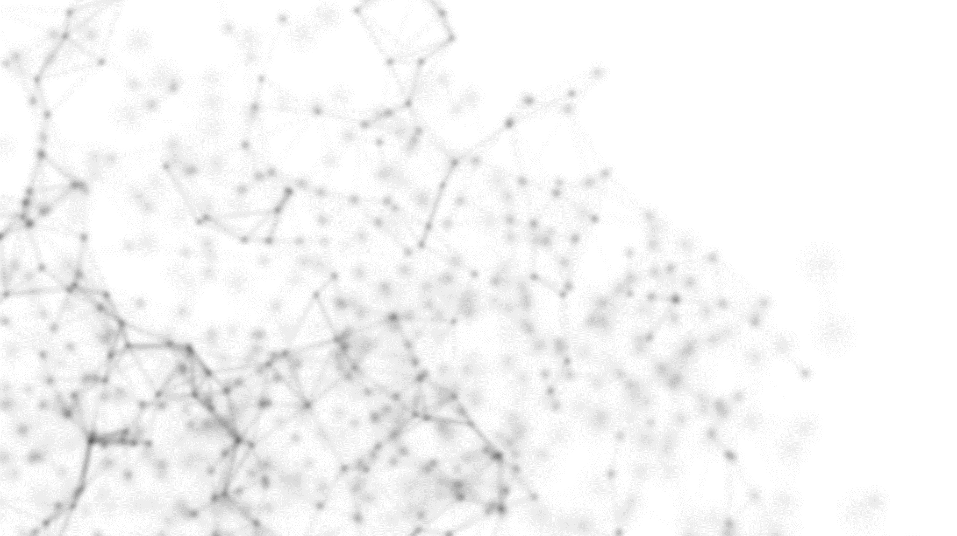




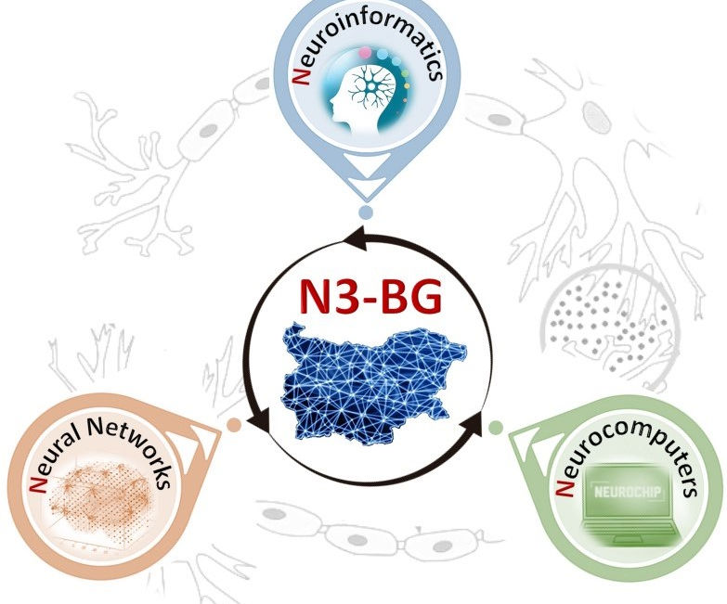
Deep Learning Models for Fetal Monitoring and Decision Support in Labour
(A three-year EPSRC project (£762K) - collaboration of University of Portsmouth and University of Oxford)
Dr. Ivan Jordanov, Principal Investigator,
Reader, University of Portsmouth, UK
N3-BG presentation, May 2023

Slide 2
Outline
Introduction: Cardiotocography (CTG) and Fetal heart rate (FHR) monitoring
Dataset
Data pre-processing
  Data filtering, cleaning, and augmentation
  Gap imputation
  Fourier and Wavelet transforms (Spectrograms & Scalograms)
DL Models
Results
Conclusion

Slide 3
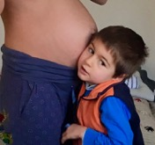
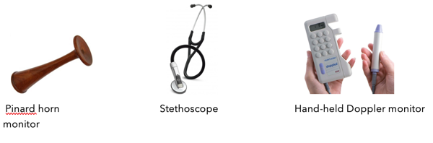
Introduction
Pinard horn Stethoscope Hand-held Doppler
low-risk labours, ~40% of all UK births
Fetal heart rate remains the only vital sign of the fetus wellbeing that can be monitored continuously during labour.
People have been listening to the heart rate of babies over centuries with tools like this old Pinard horn.
Notes:
In the UK about 40% of labours are classed as low risk and are monitored with this hand-held probe that is just put on the abdomen and we can hear the heart beating at different times during labour.
For high risk pregnancies CTG machines are used –allowing continuous monitoring of the heart rate, maternal pulse and contractions, usually on a paper strip that can be 1 or 10 or 20 hours long.
Clinicians look at the CTG to judge if the baby is at risk and where really needed, they can do an emergency caesarean section to get the baby out before it is injured.
CTG is routinely used globally & there is nothing better or comparable, it is the current standard recommended by NICE for high-risk labours, and it will be used in the foreseeable future.
But as depicted by the reviewers, there are many limitations of the current situation, CTG interpretation has very poor accuracy, and that is why we are proposing this research …

Slide 4
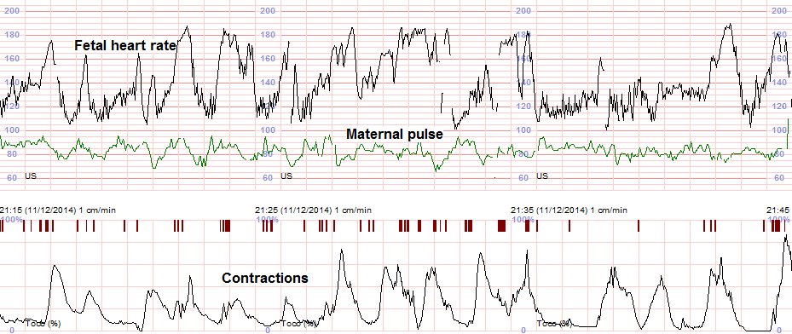
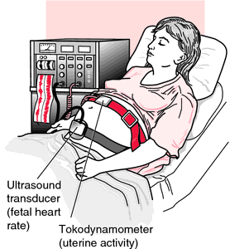
Cardiotocography (CTG)
For high risk pregnancies (~60% in the UK), CTG machines are used – standard non-invasive, real time, continuous measurement of fetal heart rate (FHR) and maternal pulse and uterine contractions (usually on a paper strip that can be 1, 10, 20, or more record hours long).
Notes:
The challenge is that fetal heart rate remains the only vital sign of the baby that we can monitor continuously during labour.
People have been listening to the heart rate of babies over centuries with tools like this old pinard.
In the UK about 40% of labours are classed as low risk and are monitored with this hand-held probe that is just put on the abdomen and we can hear the heart beating at different times during labour.
Clinicians look at the CTG to judge if the baby is at risk and where really needed, they can do an emergency caesarean section to get the baby out before it is injured.
CTG is routinely used globally & there is nothing better or comparable, it is the current standard recommended by NICE for high-risk labours, and it will be used in the foreseeable future.
But, currently there are many limitations, CTG interpretation has very poor accuracy, and that is why we are carrying out this research …

Slide 5
UPatch for continuous sensing of deep tissues
Ultrasound is the primary underpinning technology used in the evaluation of fetal wellbeing (ultrasound imaging, Doppler investigations, CTG). Compared to other medical imaging methods, such as X-ray computed tomography and magnetic resonance imaging, ultrasound is safer, less expensive, and more versatile.
An UPatch for blood flow monitoring in an adult. (a) Image of a 12 x 12 wearable ultrasound array. The inset shows a zoomed image of four elements in the array connected by serpentine metal wires, with a pitch (λ) of 0.8 mm. Tx = transducer. (b) Image of the device on the adult neck. Color flow image of the (c) carotid artery and (d) jugular vein reconstructed from signals received by the ultrasound array.
(Nature Biomedical Engineering).
Notes:
The challenge is that fetal heart rate remains the only vital sign of the baby that we can monitor continuously during labour.
People have been listening to the heart rate of babies over centuries with tools like this old pinard.
In the UK about 40% of labours are classed as low risk and are monitored with this hand-held probe that is just put on the abdomen and we can hear the heart beating at different times during labour.
Clinicians look at the CTG to judge if the baby is at risk and where really needed, they can do an emergency caesarean section to get the baby out before it is injured.
CTG is routinely used globally & there is nothing better or comparable, it is the current standard recommended by NICE for high-risk labours, and it will be used in the foreseeable future.
But, currently there are many limitations, CTG interpretation has very poor accuracy, and that is why we are carrying out this research …

Slide 6
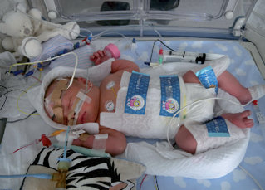
Why fetal heart rate (FHR) monitoring?
Insufficient oxygen exchange between the mother and the fetus leads to changes in fetal pH - which then subsequently results in signs of distress. One such sign is a change in fetal heart rate (FHR).
Reliable monitoring of the health of babies during childbirth remains a massive unmet clinical need worldwide (~3 million neonatal deaths (Lee et al., 2013) annually).
In the UK alone, over 1200 otherwise healthy term babies sustain permanent brain injury during birth each year (these are otherwise healthy babies that made it to term). A proportion will die around the time of birth, but majority will have a long life of disability.

Slide 7
The challenge
In 2020/21 NHS spent over £4.1 billion on litigation costs (settling obstetric claims), 59% of which to clinical negligence payments.
A national priority
MBRRACE-UK Perinatal Confidential Enquiry intrapartum-related perinatal deaths found 8 in 10 deaths were potentially avoidable
The Government’s mandate to NHS England: by 2030, to halve the rate of stillbirths, neonatal deaths and brain injuries around the time of birth
The aim is to identify the risk of complications for the fetal during labour, and help Obstetricians take informed decision for emergency intervention (e.g., Caesarean section), in order to prevent death or permanent brain injury.
Notes:
Contractions squeeze the placenta, cord and baby, causing a small proportion of babies to suffocate.
In the UK alone, this causes about 1200 babies to sustain injury each year, and these are babies that are otherwise healthy and made it to term. A proportion will die around the time of birth, but majority will have a long life of disability.
Over 60% of these incidents are deemed preventable with better monitoring and care during labour.
This is reflected in the NHS litigation bill which is becoming unsustainable and it is a national priority to halve the number of such incidents.

Slide 8
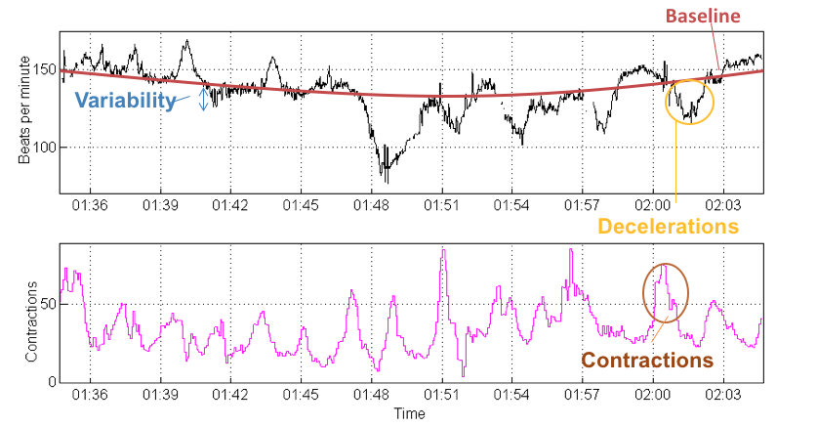
CTG Interpretation
By looking at various different aspects of the baby's heart rate, doctors and midwives can assess how the baby is coping.
Abnormal patterns, such as “late” decelerations, can indicate fetal hypoxia.

Slide 9
Challenges of CTG monitoring?
CTG is an overly sensitive test: 60% of babies born after their CTG showed such changes (e.g., “decelerations”), were not acidotic (Beard&Finnegan, 2019).
CTG interpretation has low observer agreement rates, and even experts differ in their interpretation of the same CTG.
Uninterpretable CTGs are also common.
Computerised methods to interpret CTG data?
Computer-based methods for detecting abnormal CTG patterns automatically are still subject to limitations.
Systematic reviews of three randomised controlled trial studies showed that computerised CTGs did not manage to improve rates of neonatal outcomes.
More work is needed to improve the accuracy of computerised CTG analysis.

Slide 10
Objectives
Innovative Deep Learning (DL) models processing up to 12 hours before delivery CTG records (and other clinical factors) for monitoring labour progression, fetal well-being, and risk assessment.
The developed DL models and software to be embedded on a handheld device used by Obstetricians to take informed decision if there is a need of intervention, when assessing the risk of complications for the fetal health, providing reliable and timely (early enough) predictions.
Embedded software to be able to capture and analyse in real time CTG signals from standard hospital fetal monitors and infer the risk of birth complications.

Slide 11
The Dataset
Over 100,000 births at term CTG records, including clinical factors and outcomes routinely collected as per standard clinical care in term births in Oxford, UK, since 1993.
In this study n= 60,985.
60,985
Excluded: n = 9,526
935 breech presentation
248 metabolic disorders
1,039 congenital problems
15 missing data
7,299 signals with 2nd stage tracings
n = 51,449
  Training
  n = 43,677
Births with severe case = 384
Without severe compromise = 43,293
Testing
n = 7,772
Births with severe case = 68
Without severe compromise = 7,704

Slide 12
Labour outcome definitions (labels)
Exclusive outcome groups |  | Dataset
Severe | Composite outcome of: stillbirth; neonatal death; neonatal encephalopathy; intubation or cardiac massage followed by admission to neonatal intensive care for ≥ 48hrs; seizures. | 0.82%
Moderate (Acidemia) | Umbilical cord arterial pH < 7.05 without severe compromise | 2.69%
Mild | 7.05 ≤ pH < 7.15 without severe compromise | 14.03%
Normal | pH >= 7.15 without severe compromise | 82.46%

Slide 13
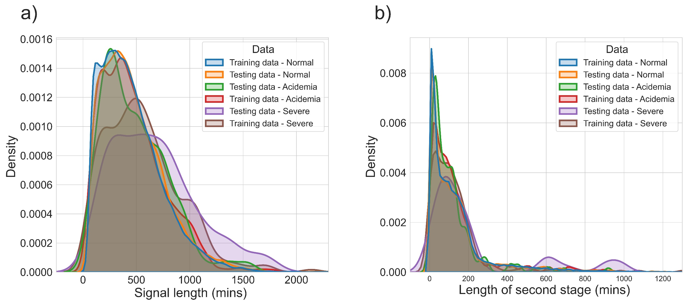
Dataset
Distribution of signal length and length of second stage in the training and testing datasets for each class.

Slide 14
Data filtering and cleaning
The CTG datasets are obtained with standard fetal monitors at a 4Hz sampling rate for the FHR and 2Hz for the uterine contraction signals. The FHR signals are downsampled to 0.25Hz.
FHR > 230 or < 50 beats per minute (bpm) are cleaned using a bespoke algorithm
The high-frequency noise in the FHR signal is filtered using a low pass Butterworth filter (order = 1)

Slide 15
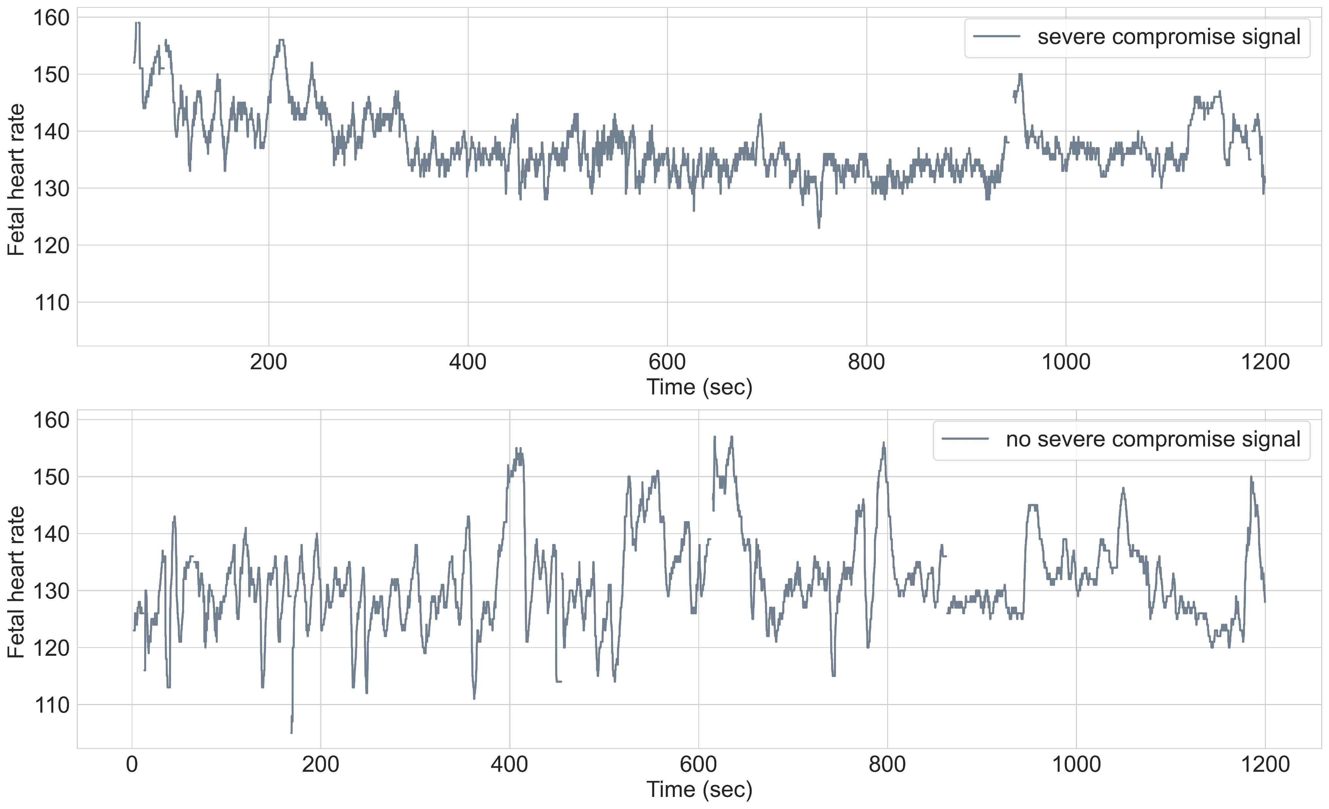
A snippet of a 20-min signals window: top – severe compromise; bottom - normal

Slide 16
Gap Imputation of the CTG signals
Gaps are common in FHR signals due to many factors: poor sensor placement; movement of the mother and fetus; common and sudden changes of the signal during decelerations and contractions; limitations of the sensors, etc.
Several methods have been proposed for FHR imputation: Linear Interpolation; Cubic Spline Interpolation; Sparse Representation with Dictionaries; Gaussian processes (GP); and others.
However, the performance of the gap imputation techniques has been evaluated only on small datasets and their effect on classification accuracy has not been investigated.

Slide 17
Gap imputation
  Gap lengths of 2, 6, 9 and 15 data points considered (1p = 4 sec) for the experiment to simulate short, moderate and long gaps. These gaps are introduced at three locations (start, middle, and end) to investigate the effect of both gap length and location on the performance of the imputation techniques
Two aspects of the gap imputation investigated:
  ability to recover artificially introduced gaps, which is assessed by introducing artificial gaps with varying gap lengths at various locations in the signal;
  the impact on the classification performance of CNN, i.e., to select the imputation technique that results in an optimal classification of births with and without severe compromise.

Slide 18
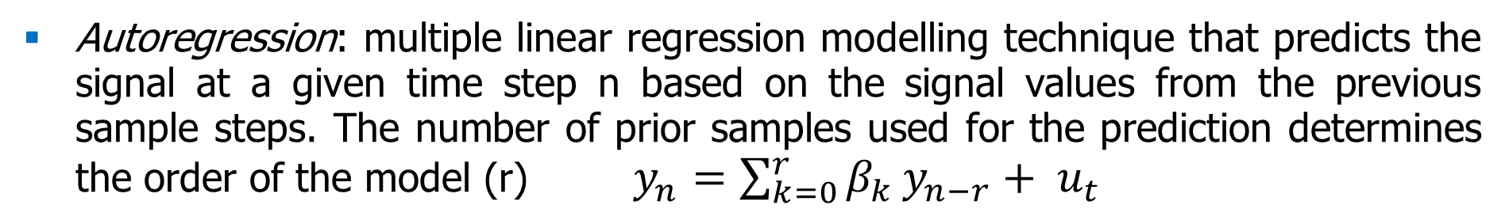
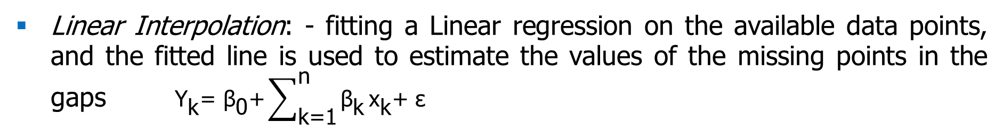
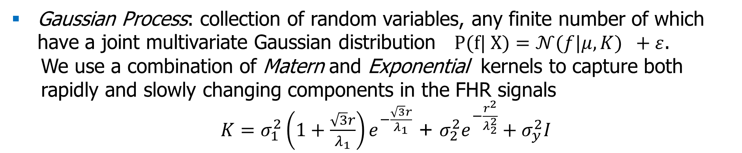
Gap imputation
Linear Interpolation: - fitting a Linear regression on the available data points, and the fitted line is used to estimate the values of the missing points in the gaps ${\text{Y}}_{\text{k}}\text{= }{\text{β}}_{\text{0}}\text{+}\sum_{\text{k}\text{=1}}^{\text{n}}{{\text{β}}_{\text{k}}}{\text{x}}_{\text{k}}\text{+ }\text{ε}$
Autoregression: multiple linear regression modelling technique that predicts the signal at a given time step n based on the signal values from the previous sample steps. The number of prior samples used for the prediction determines the order of the model (r) $y_{n}=\sum_{k=0}^{r}{β_{k}}y_{n−r}+ u_{t}$
Gaussian Process: collection of random variables, any finite number of which have a joint multivariate Gaussian distribution $P(f| X)=𝒩(f|μ,K) +ε$.
We use a combination of Matern and Exponential kernels to capture both rapidly and slowly changing components in the FHR signals
  $K=σ_{1}^{2}\left(1+\frac{\sqrt{3}r}{λ_{1}}\right)e^{−\frac{\sqrt{3}r}{λ_{1}}}$ + $σ_{2}^{2}e^{−\frac{r^{2}}{λ_{2}^{2}}}+σ_{y}^{2}I$

Slide 19
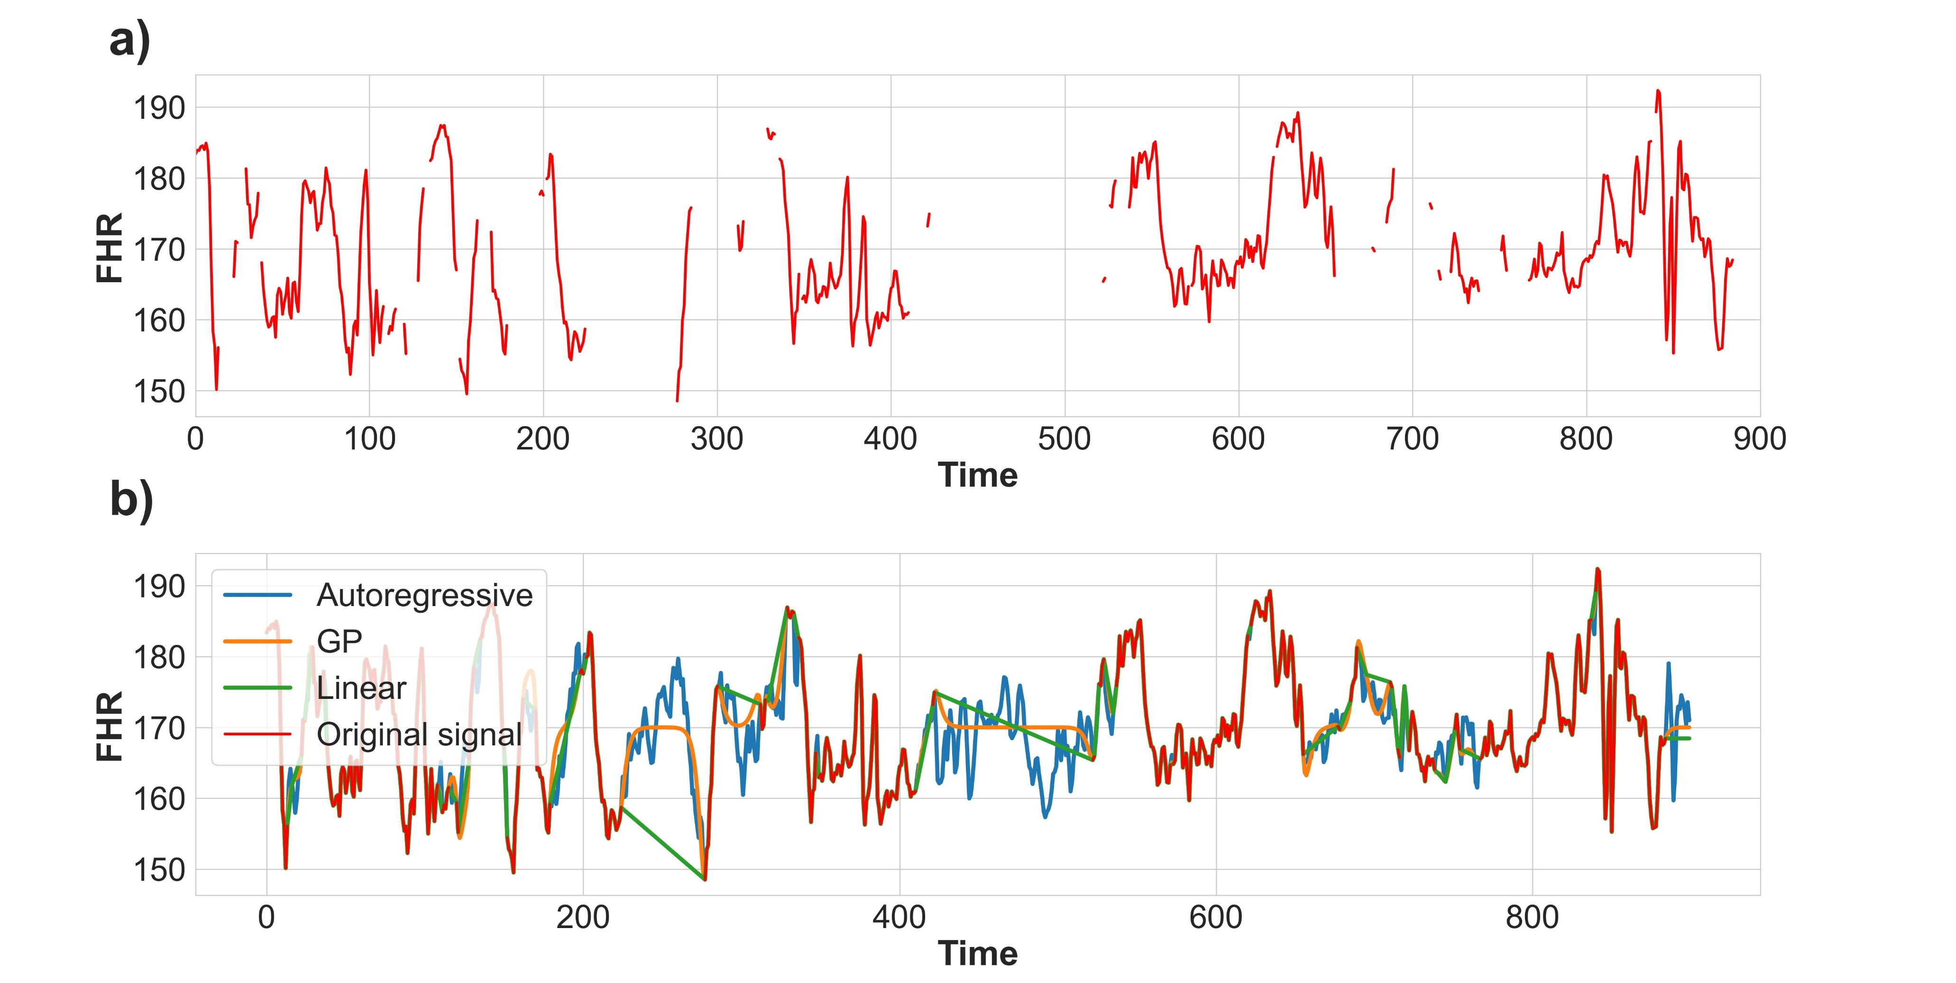
Gap imputation

Slide 20
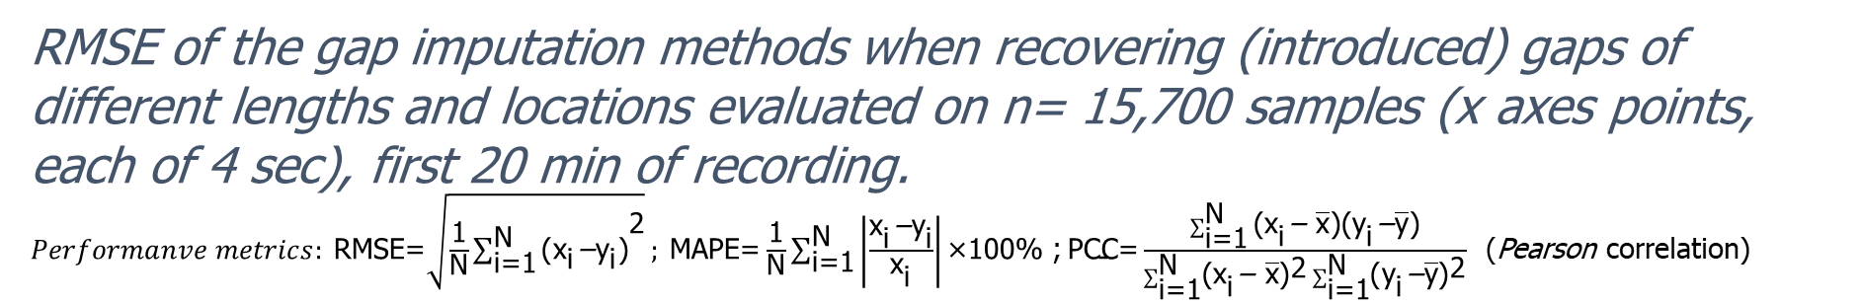
RMSE of the gap imputation methods when recovering (introduced) gaps of different lengths and locations evaluated on n= 15,700 samples (x axes points, each of 4 sec), first 20 min of recording. $Performanve metrics: \text{RMSE}\text{=}\sqrt{\frac{\text{1}}{\text{N}}{\sum_{\text{i}\text{=1}}^{\text{N}}{\text{(}{\text{x}}_{\text{i}}\text{−}{\text{y}}_{\text{i}}\text{)}}}^{\text{2}}}; \text{MAPE}\text{=}\frac{\text{1}}{\text{N}}\sum_{\text{i}\text{=1}}^{\text{N}}{\left|\frac{{\text{x}}_{\text{i}}\text{−}{\text{y}}_{\text{i}}}{{\text{x}}_{\text{i}}}\right|}\text{×100\%}$ ;$\text{PCC}\text{=}\frac{\sum_{\text{i}\text{=1}}^{\text{N}}{\text{(}}{\text{x}}_{\text{i}}\text{−} \overline{\text{x}}\text{)(}{\text{y}}_{\text{i}}\text{−}\overline{\text{y}}\text{)}}{\sum_{\text{i}\text{=1}}^{\text{N}}{{{\text{(}\text{x}}_{\text{i}}\text{−} \overline{\text{x}}\text{)}}^{\text{2}}}\sum_{\text{i}\text{=1}}^{\text{N}}{{\text{(}{\text{y}}_{\text{i}}\text{−}\overline{\text{y}}\text{)}}^{\text{2}}}}$ (Pearson correlation)

Slide 21
Results - Gap recovery performance
Method | Gap length | RMSE (BPM) |  |  | MAPE (%) |  |  | PCC
 |  | Gap location |  |  | Gap location |  |  | Gap location
 |  | Start | Middle | End | Start | Middle | End | Start | Middle | End
Linear | 2 | 5.15 | 2.12 | 5.20 | 3.79 | 1.42 | 3.63 | -0.08 | 0.38 | -0.10
 | 6 | 11.34 | 3.14 | 11.28 | 8.33 | 1.95 | 14.38 | -0.04 | 0.32 | -0.05
 | 9 | 15.31 | 3.60 | 15.32 | 14.87 | 2.19 | 18.38 | -0.05 | 0.31 | -0.05
 | 15 | 23.62 | 4.27 | 23.89 | 33.83 | 2.55 | 38.35 | -0.04 | 0.29 | -0.05
GP | 2 | 3.88 | 2.35 | 3.68 | 2.61 | 1.59 | 2.50 | -0.01 | 0.27 | -0.03
 | 6 | 5.91 | 3.38 | 5.81 | 3.75 | 2.11 | 3.72 | 0.0 | 0.26 | -0.01
 | 9 | 7.25 | 3.91 | 7.07 | 4.54 | 2.42 | 4.47 | 0.0 | 0.25 | -0.02
 | 15 | 9.86 | 4.76 | 9.45 | 6.10 | 2.90 | 5.89 | -0.01 | 0.23 | -0.01
Autoregressive | 2 | 4.44 | 3.01 | 4.25 | 3.00 | 2.04 | 2.86 | 0.08 | 0.23 | 0.07
 | 6 | 5.91 | 4.25 | 5.75 | 3.72 | 2.66 | 3.63 | 0.07 | 0.19 | 0.07
 | 9 | 6.40 | 4.76 | 6.22 | 3.97 | 2.92 | 3.85 | 0.06 | 0.18 | 0.07
 | 15 | 6.97 | 5.41 | 6.82 | 4.23 | 3.25 | 4.14 | 0.07 | 0.17 | 0.07

Slide 22
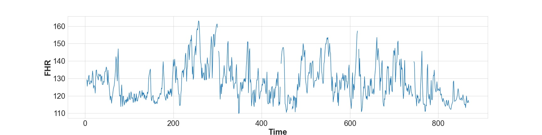
Data augmentation
Severe compromised samples training data augmented from 1-hour segment
  a one-hour long traces are extracted starting from the last hour until the start of the recording (records with less than 50% signal loss)
  sliding window (20 min), stride 10 min (1 point = 4sec, 10 min=150p), due to the non-stationary nature of the CTG data, the characteristics vary with time (e.g., as the birth approaches, the rate of contractions and decelerations generally increases, leading to easier detection of acidemia cases)
  over sampling (factor 2)

Slide 23
Model
CTGs
filtering, cleaning
gap-imputation
Deep learning model development
data preparation
model training
model evaluation

Slide 24
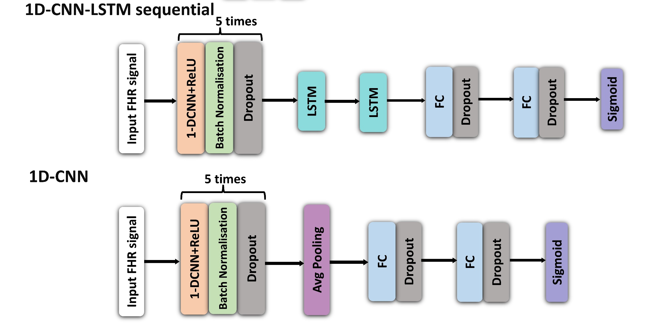
deep learning Model development: DL architecture
Architectures of 1D-CNN-LSTM sequential (top) and 1D-CNN (bottom) models.

Slide 25
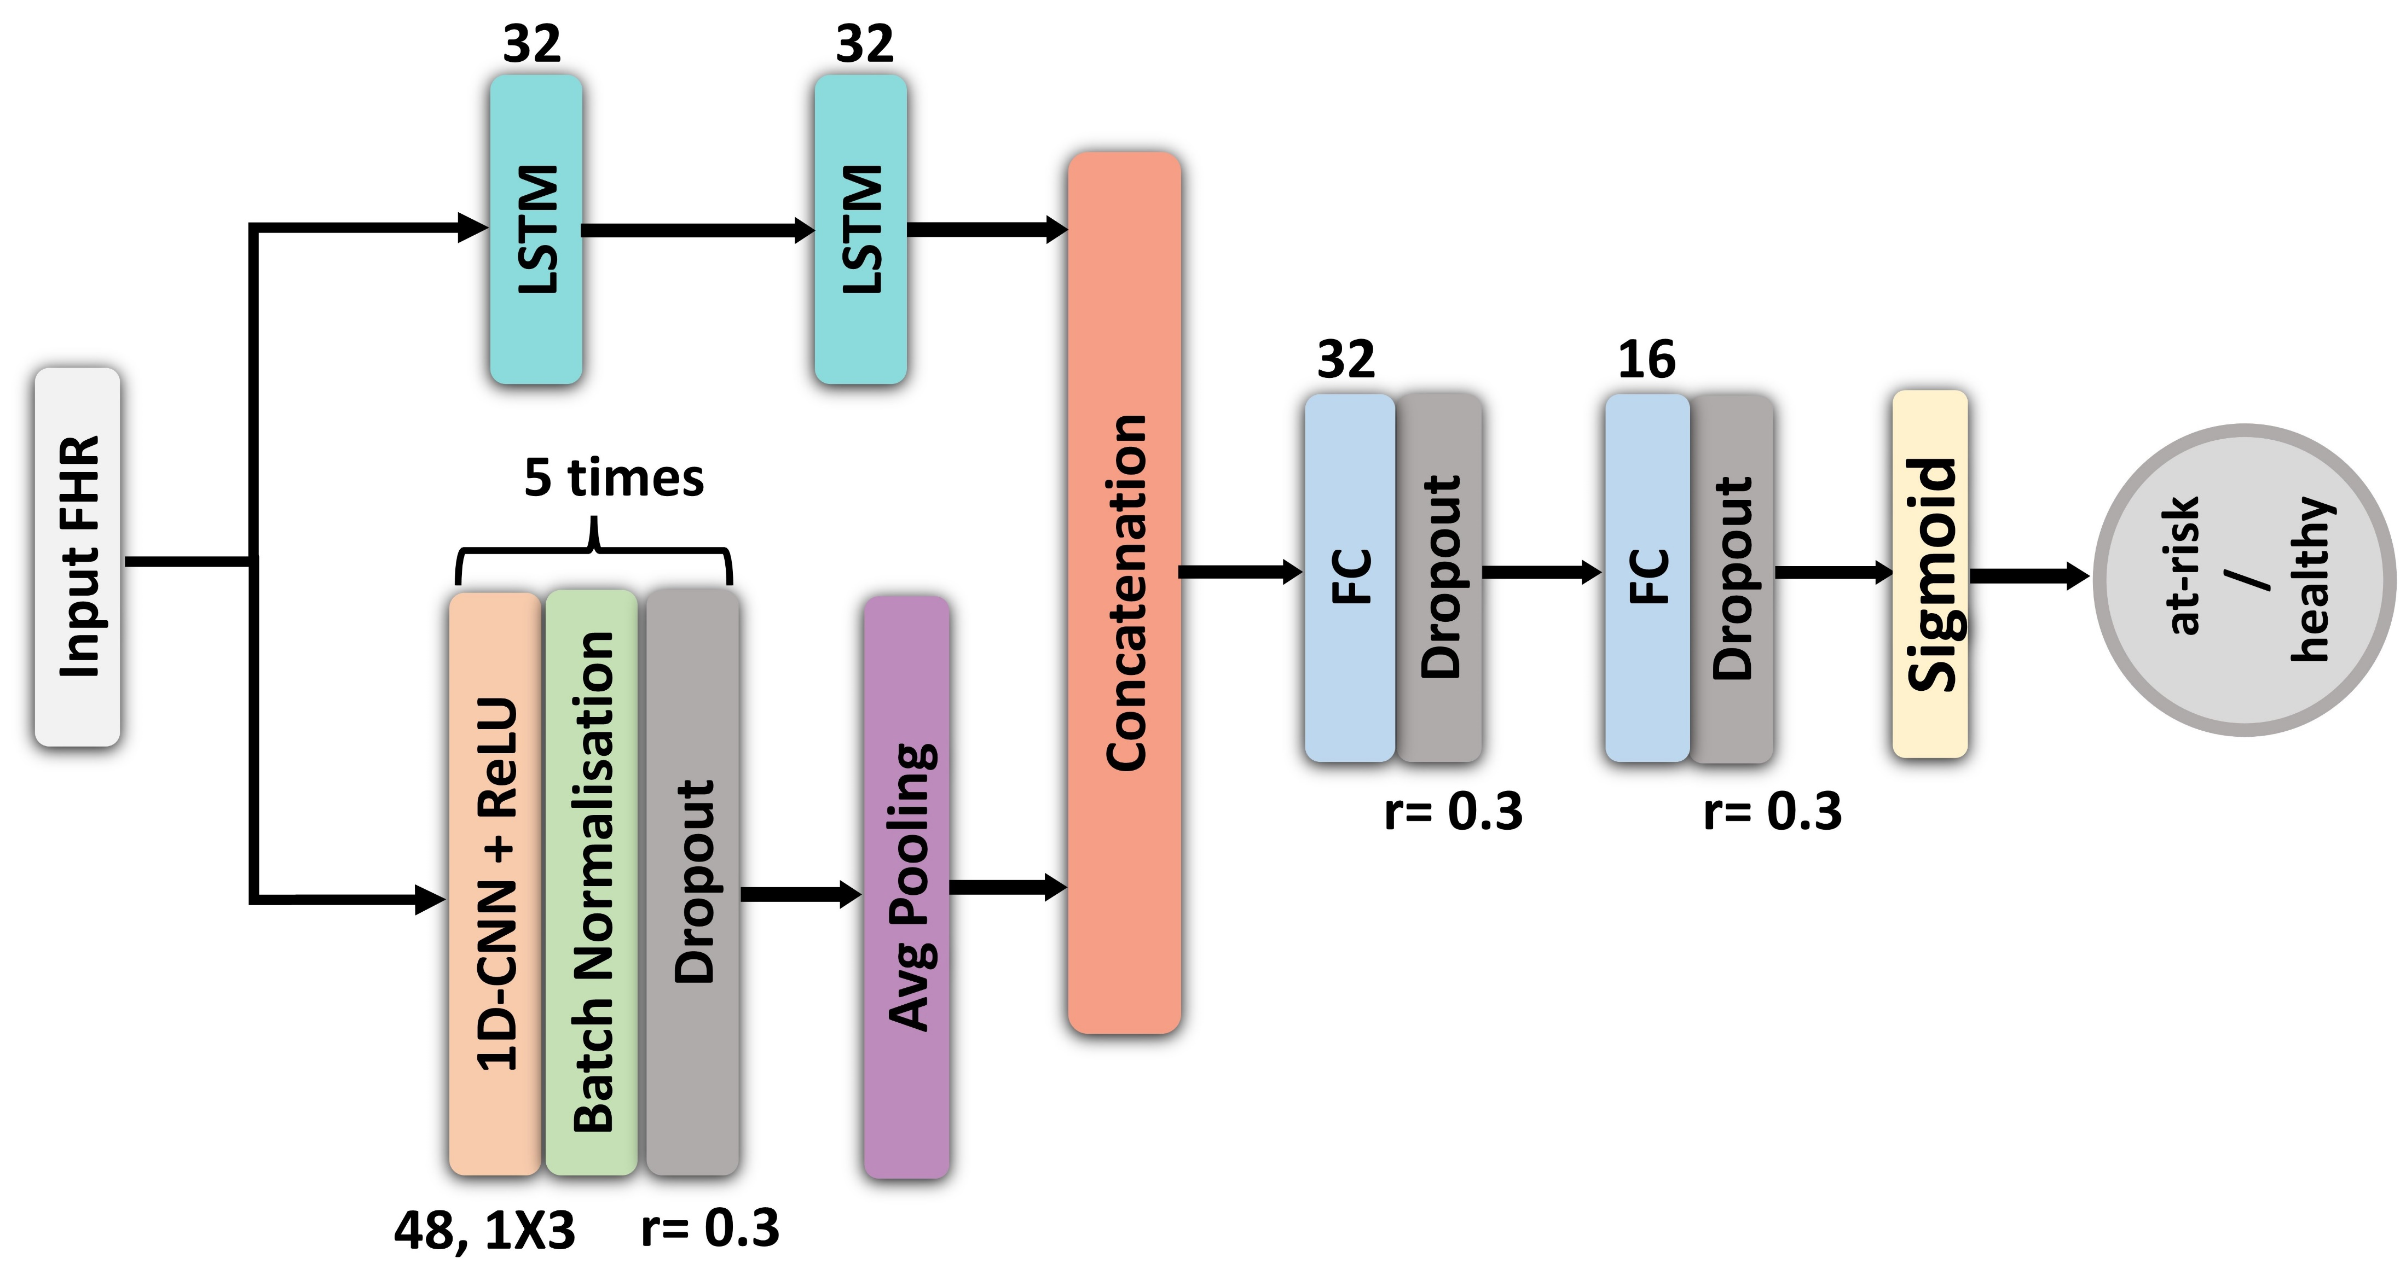
Architecture of a 1D-CNN-LSTM parallel model.

Slide 26
Model training and evaluation
All Data (n = 51449; sev = 452)
85% Training Data (n = 44245; sev = 384)
15% Test Data
(n= 7772, sev =68)
10 fold CV
Training set
Training set
…
Training set
Training set
Training set
Fold 10
Fold 1
Fold 2
Fold 9
Fold 10
Fold 2
Fold 3
Fold 10
Fold 2
Fold 3
Fold 9
Fold 2
Fold 3
Fold 9
Fold 2
Fold 3
Fold 9
Validation set
Fold 1
…
Fold 9
Fold 10
Searching the model with best performance
Fold 1
Fold 9
Fold 10
Fold 1
Fold 2
Fold 3
Fold 10
Fold 1
Fold 1
Testing set
…
Fold 1
Fold 9
Fold 10
Fold 2
Fold 3
Fold 9
Fold 10
…
Fold 1
Fold 2
Fold 3
…
Fold 9
Fold 10
Fold 1
Fold 2
Fold 3
…
Fold 9
Fold 10
Evaluation on testing data
Test Data

Slide 27
Results - Gap recovery performance
Architecture | Interpolation | PAUC (%) | Sensitivity at 5% Specificity (%)
CNN | linear | 14.3 | 13.0
 | GP | 16.4 | 14.7
 | Autoregressive | 16.7 | 15.2
 | No interpolation | 14.5 | 14.3
CNN-LSTM sequential | linear | 12.4 | 11.7
 | GP | 15.0 | 10.3
 | Autoregressive | 15.8 | 13.4
 | No interpolation
CNN-LSTM parallel | linear | 14.7 | 13.2
 | GP | 16.8 | 16.4
 | Autoregressive | 17.2 | 17.0
 | No interpolation | 16.6 | 16.5

Slide 28
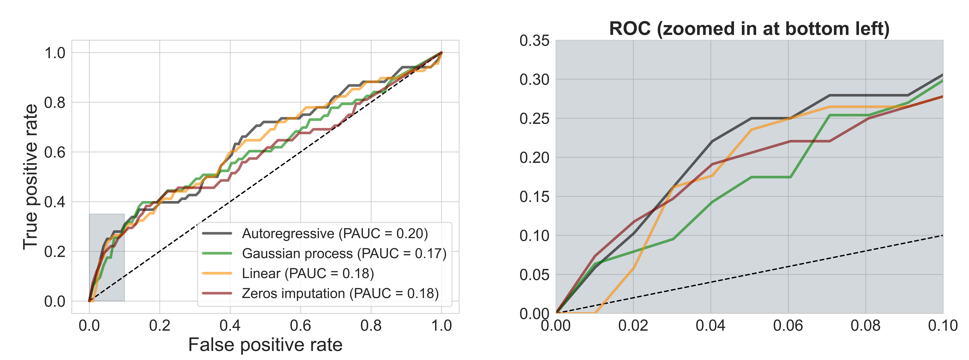
Performance Metrics and Result
The model classification performance is evaluated using PAUC and the true positive rate (TPR) at a 5% false-positive rate (FPR).
The PAUC is the AUC between 0 and 10% false-positive rates (FPR).

Slide 29
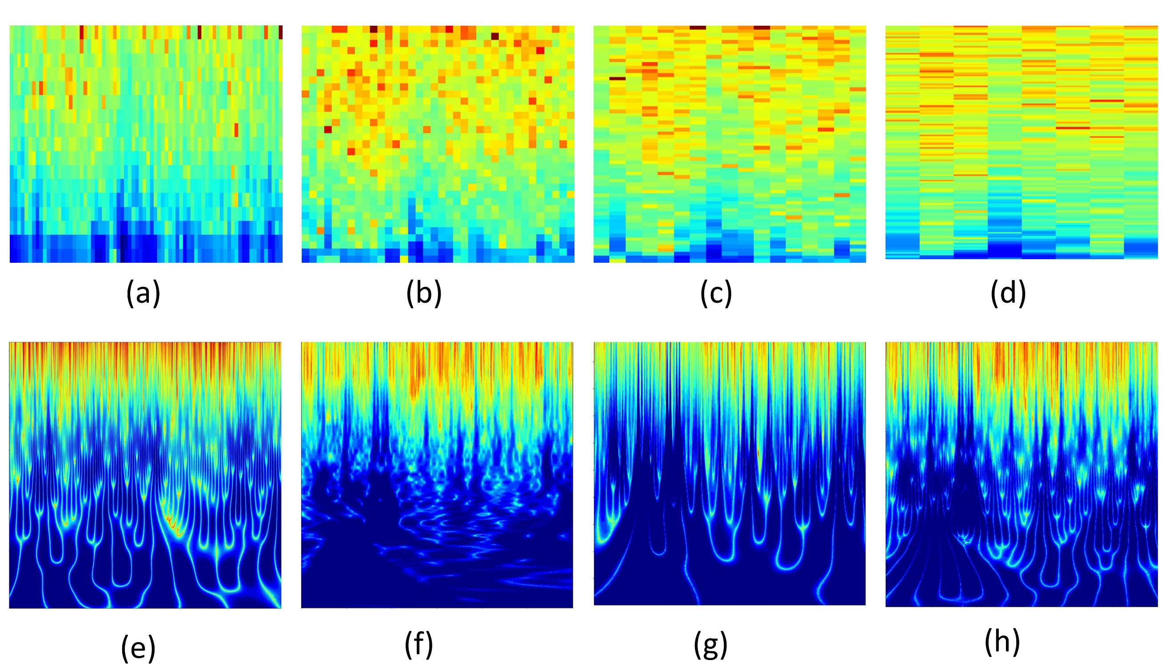
Spectrograms and Scalograms
The raw FHR signals (1D) are transformed into time-frequency representation using Fourier and Wavelet transforms, and the resulting 2D images are analysed using a 2D-CNN.
Spectrograms (Short-Time Fourier Transform) and Scalograms (Wavelet Transform) of a twenty-minute FHR signal (1 Hz). Spectrograms are computed using window length of: (a) 32; ( b) 64; (c) 128; and (d) 256; and the Scalograms using mother wavelets of: (e) mexh8; (f) morl; (cg) shan; and (h) gaus8.

Slide 30
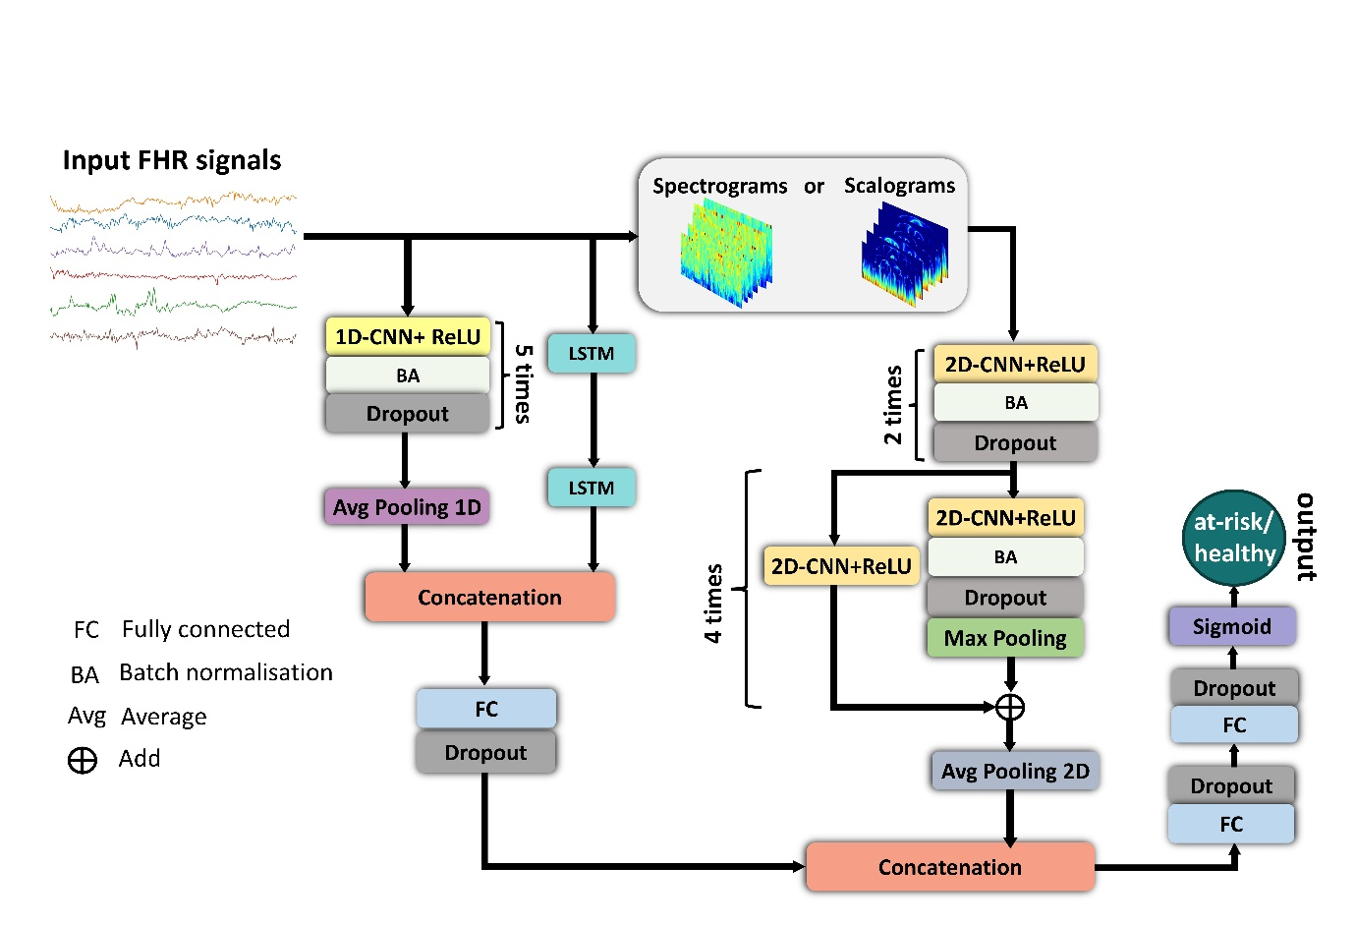
The proposed combination of 1D-CNN-LSTM and 2D-CNN architecture used for the FHR signal classification.

Slide 31
Impact of the window length on the classification performance of the spectrograms. The results are performances of the best models from a 10-fold cross-validation, evaluated on the test set (the best classification performances are given in bold).
Window length (overlap stride) | Kernel size | PAUC | Sensitivity at 0.95 Specificity
32 (16) | 3X3/5X5/7X7 | 0.09 /0.09/0.09 | 0.09/0.10/0.12
64 (32) | 3X3/5X5/7X7 | 0.11/0.07/0.09 | 0.13/0.12/0.13
128 (64) | 3X3/5X5/7X7 | 0.11/0.11/0.09 | 0.10/0.12/0.10
256 (128) | 3X3/5X5/7X7 | 0.09/0.09/0.08 | 0.10/0.13/0.13

Slide 32
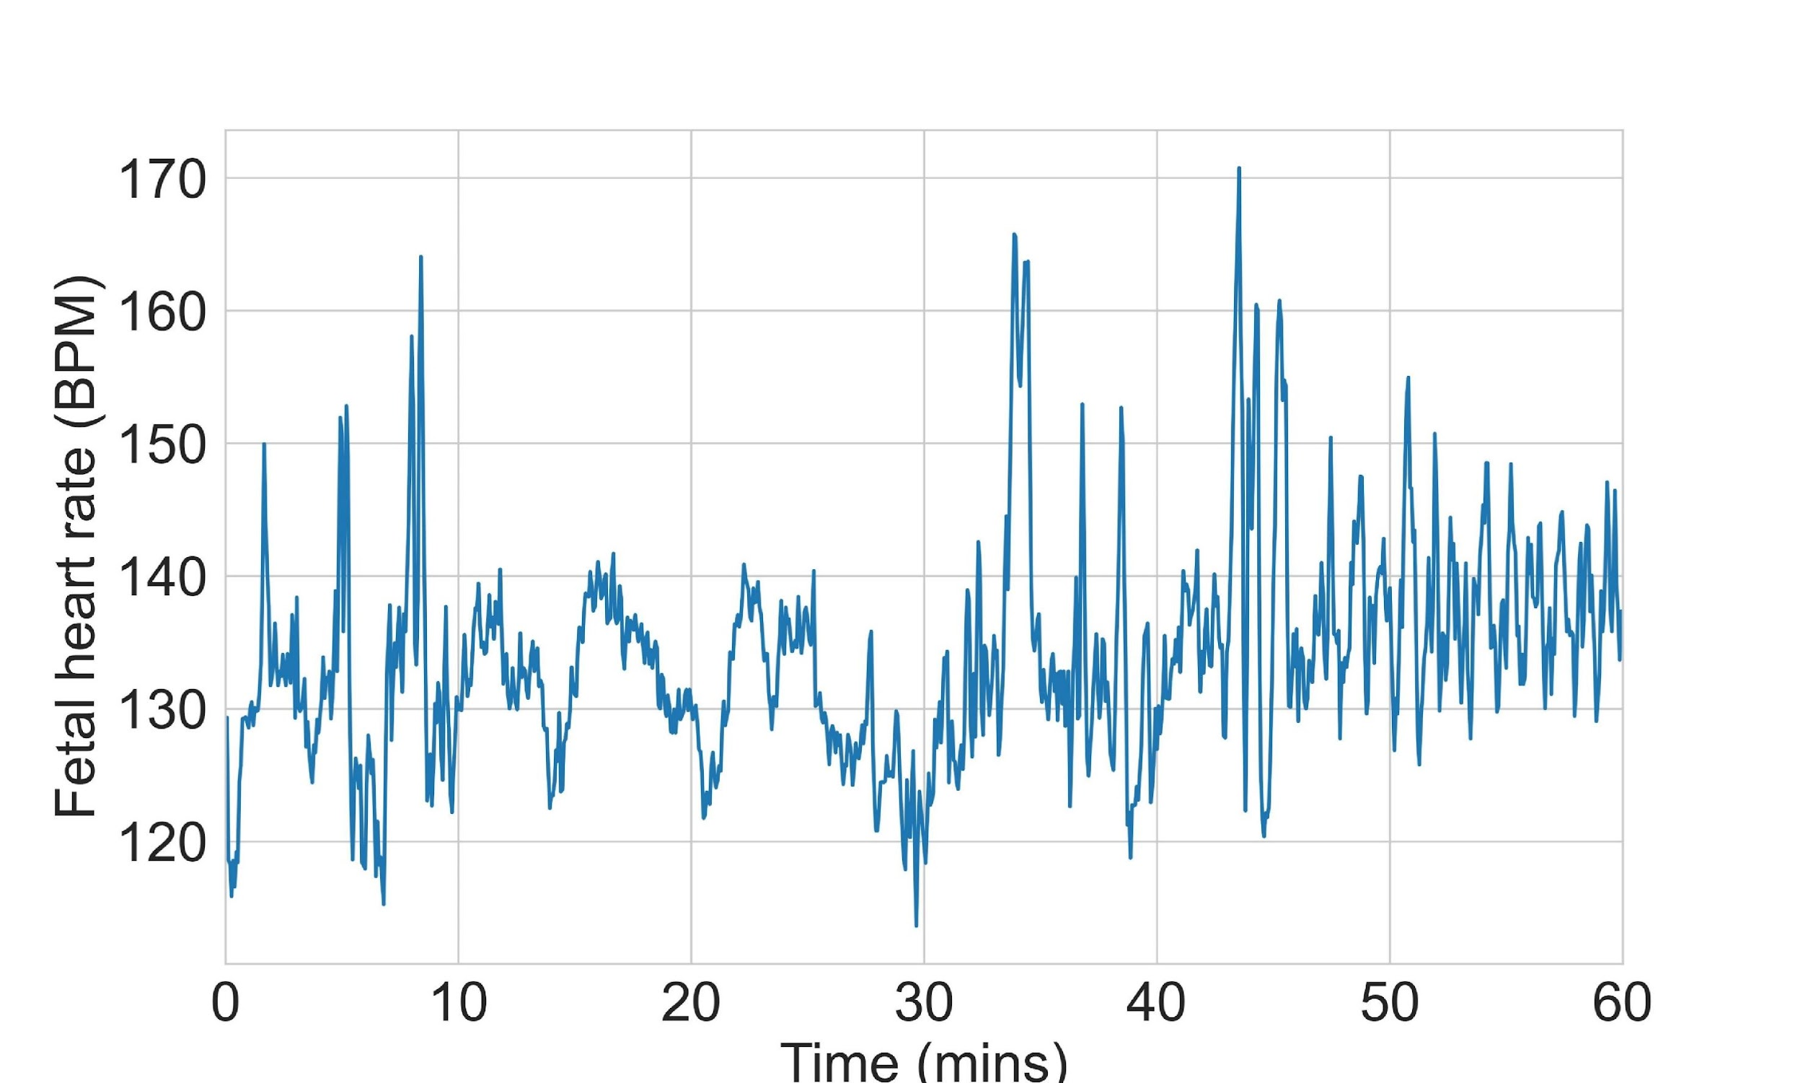
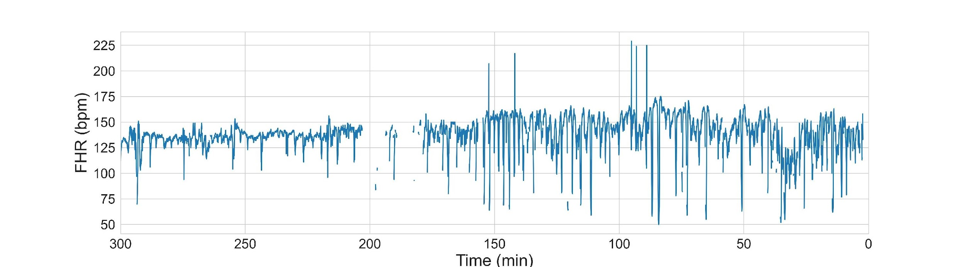
Analysing longer CTG traces
Delivery
First hour FHR
Last three hours FHR
Macro features
CTG in-between
Multi-output DL
Risk score
Time of birth

Slide 33
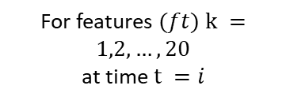
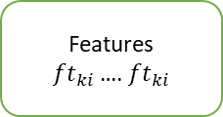
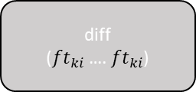

FHR features
Extracted Features
Baseline mean
Number of contractions
Number of accelerations
Number of decelerations
PRSA-DC30min (phase rectified signal averaging for deceleration capacity )
Short Term Variation
Long Term Variations
Signal stability index
Prolonged deceleration
Feature Extraction
Model training/ Evaluation
Model – RF, Neural networks, Boosted decision trees
[Baseline_diff_fh, PRSA_DC_fh]

Slide 34
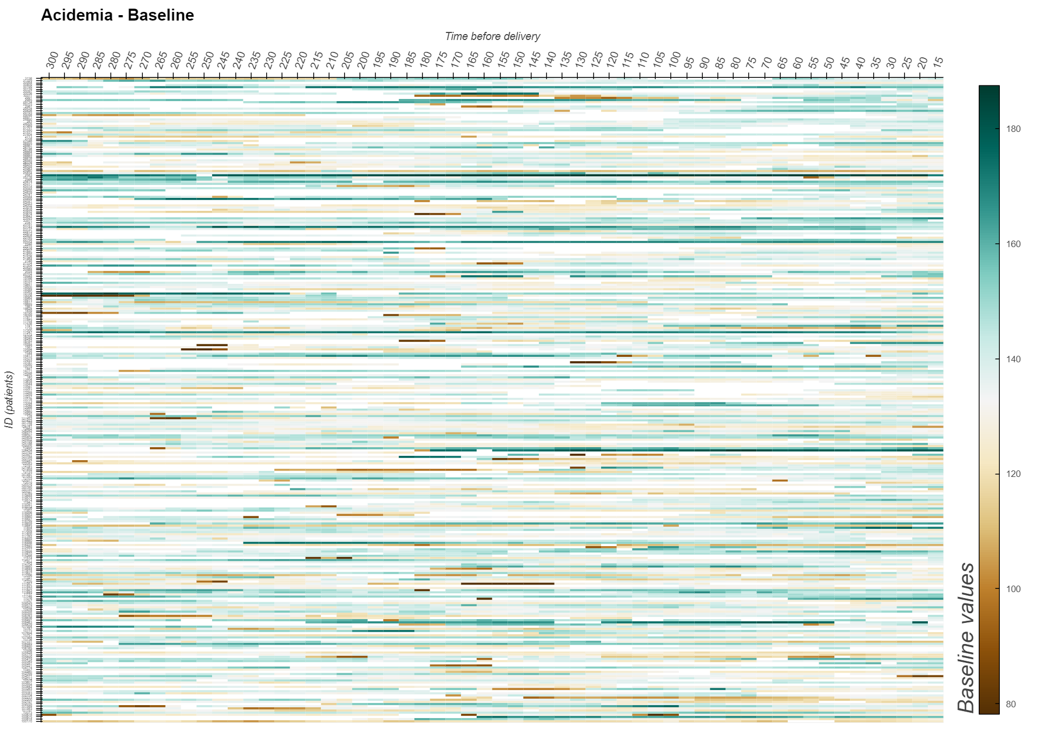
FHR features Baselines (~400 samples, 5 hours)

Slide 35
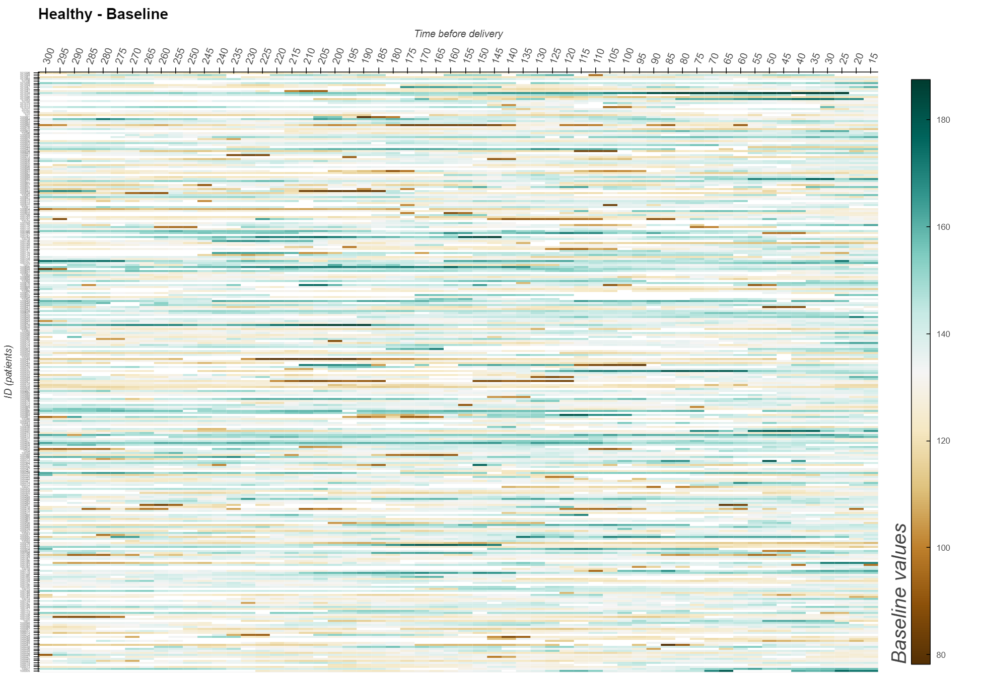

Slide 36
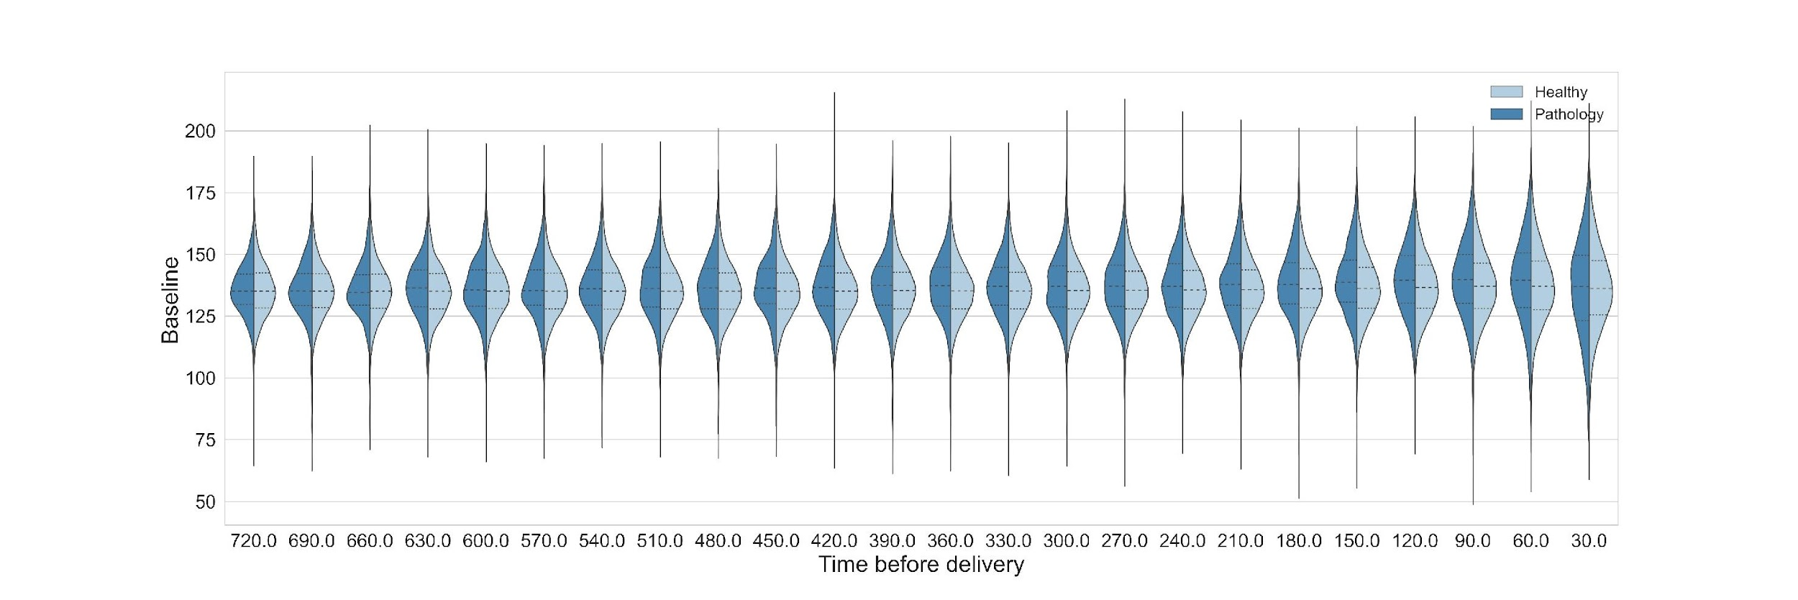
FHR features - Baselines

Slide 37
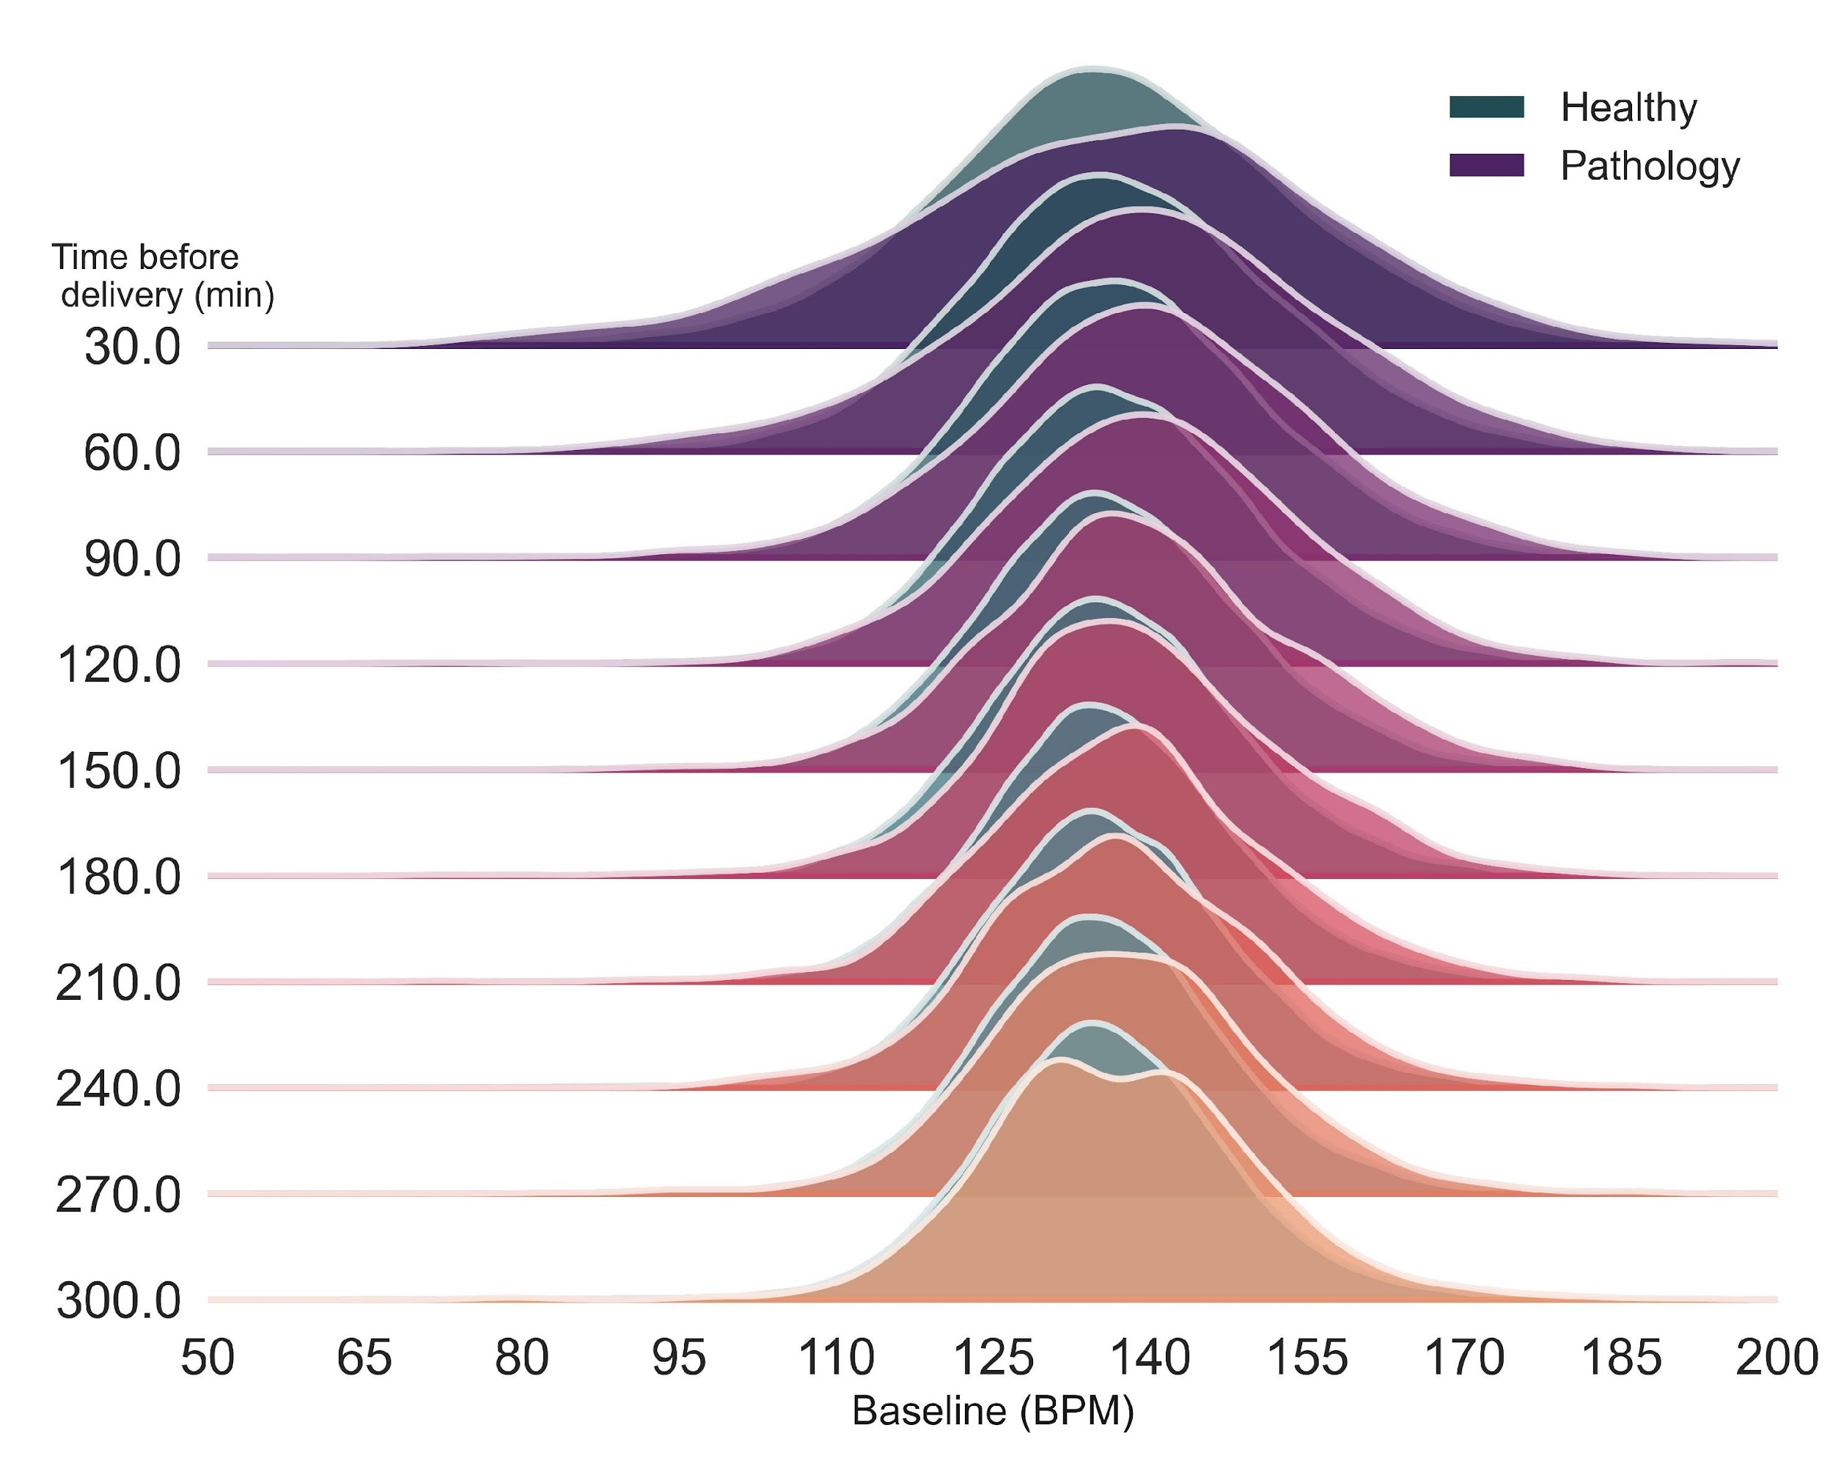
FHR features - Baseline

Slide 38
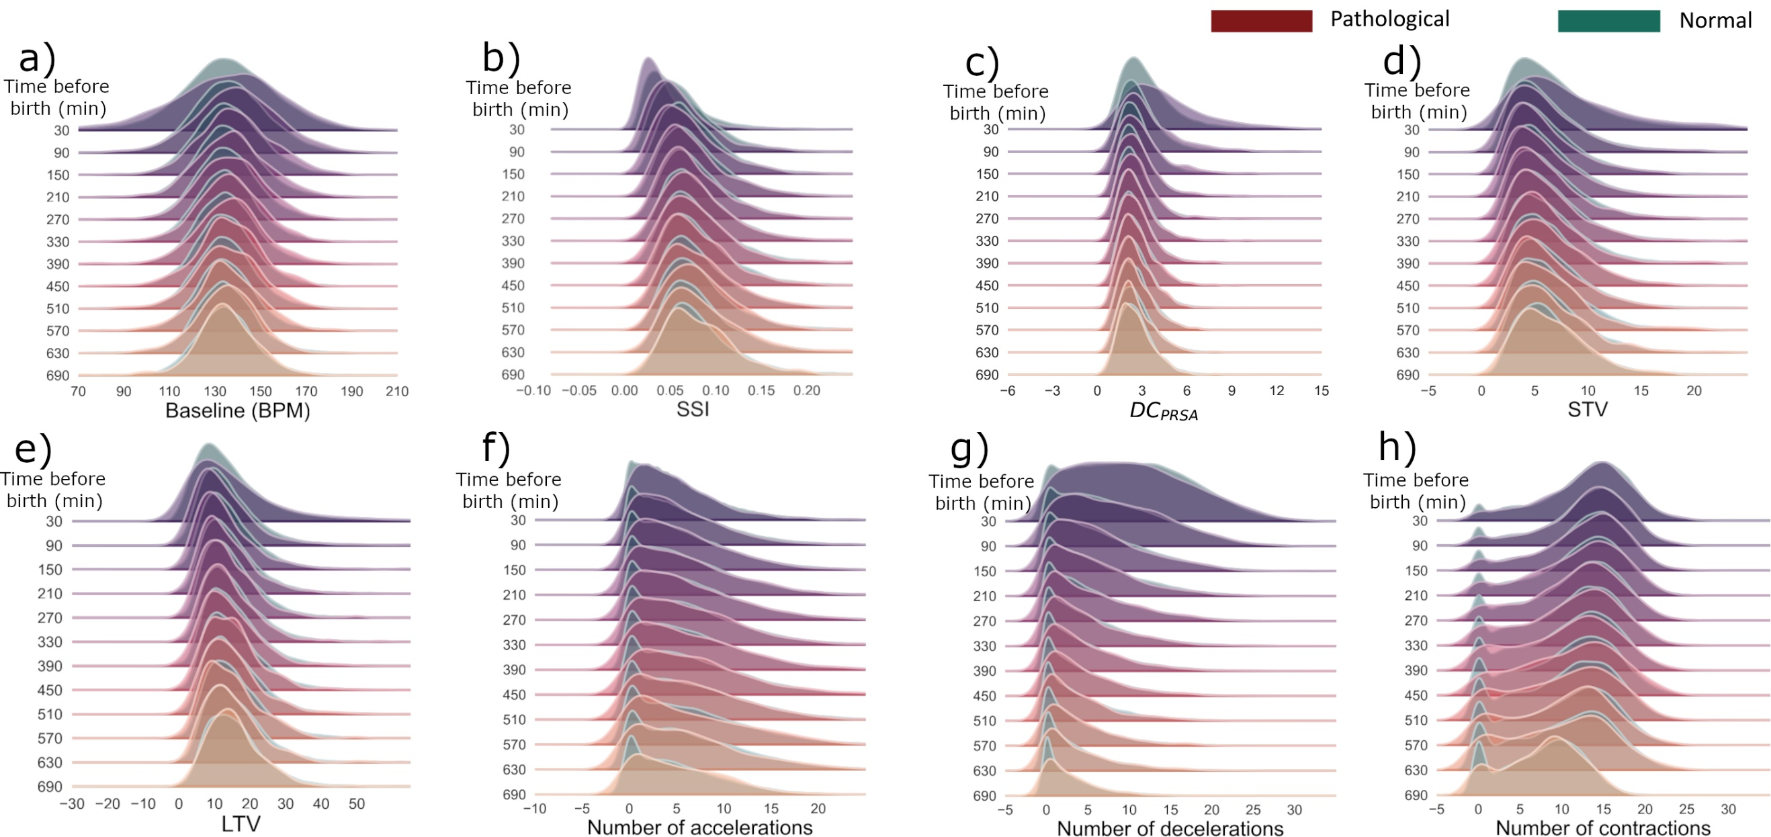
Commonly used FHR features

Slide 39
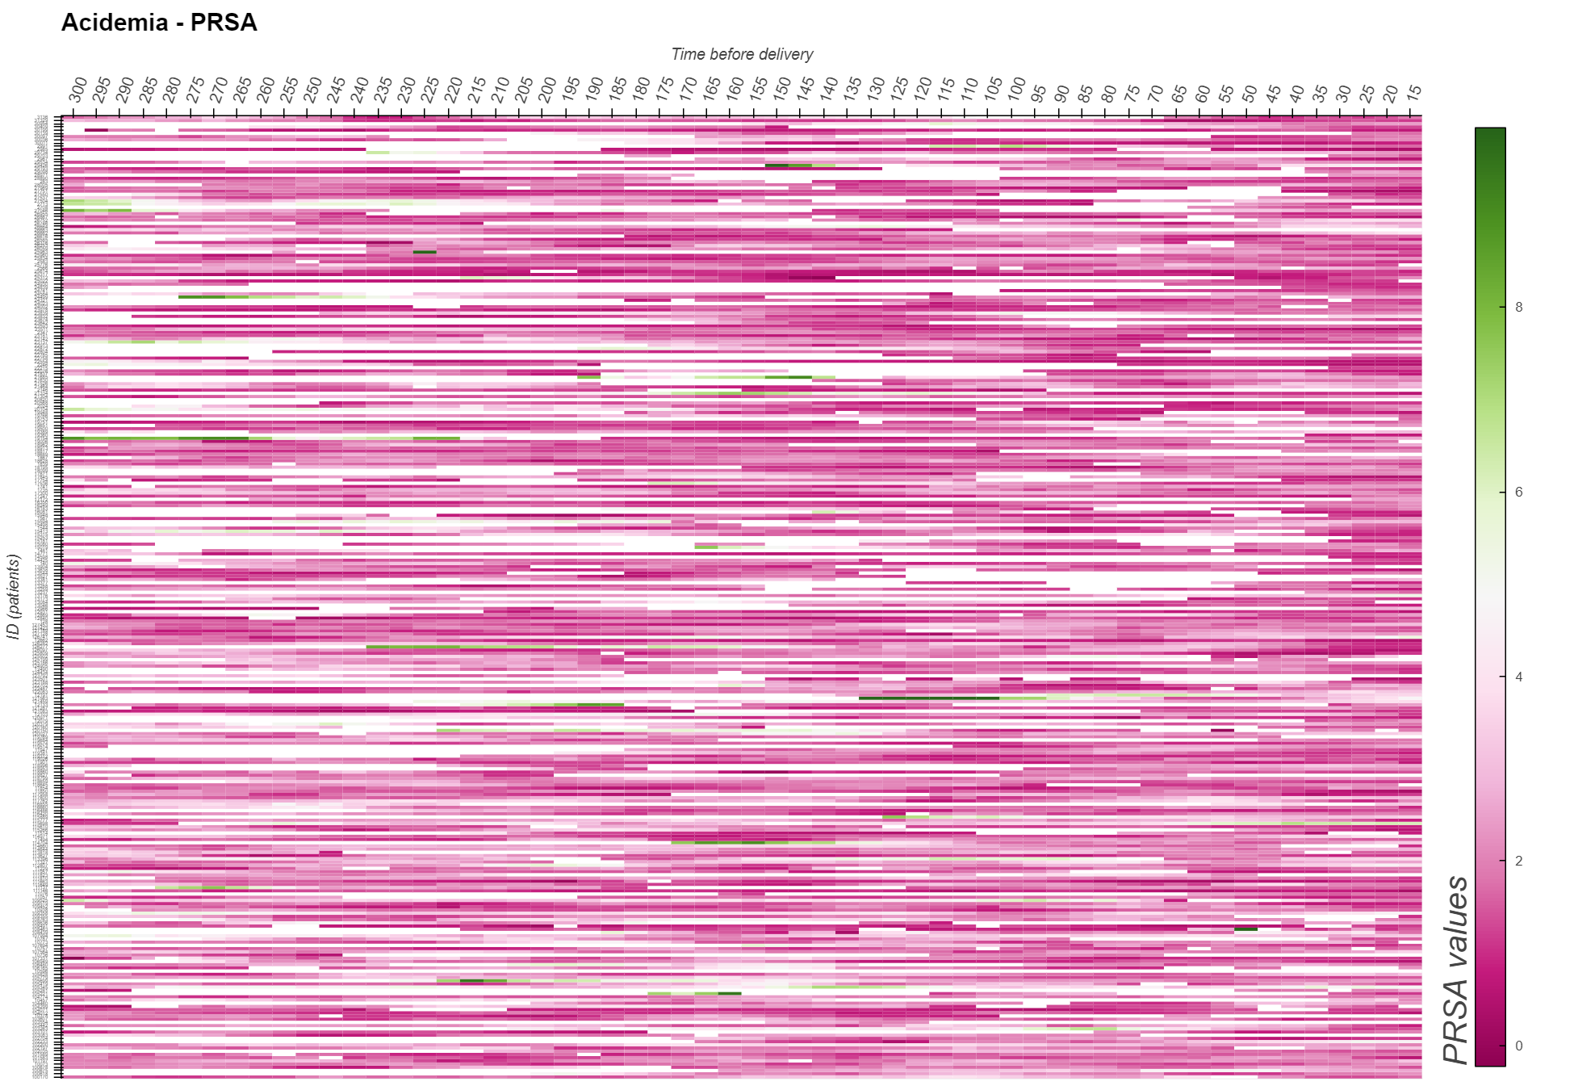
FHR features - PRSA (phase rectified signal averaging for dec. capacity)

Slide 40
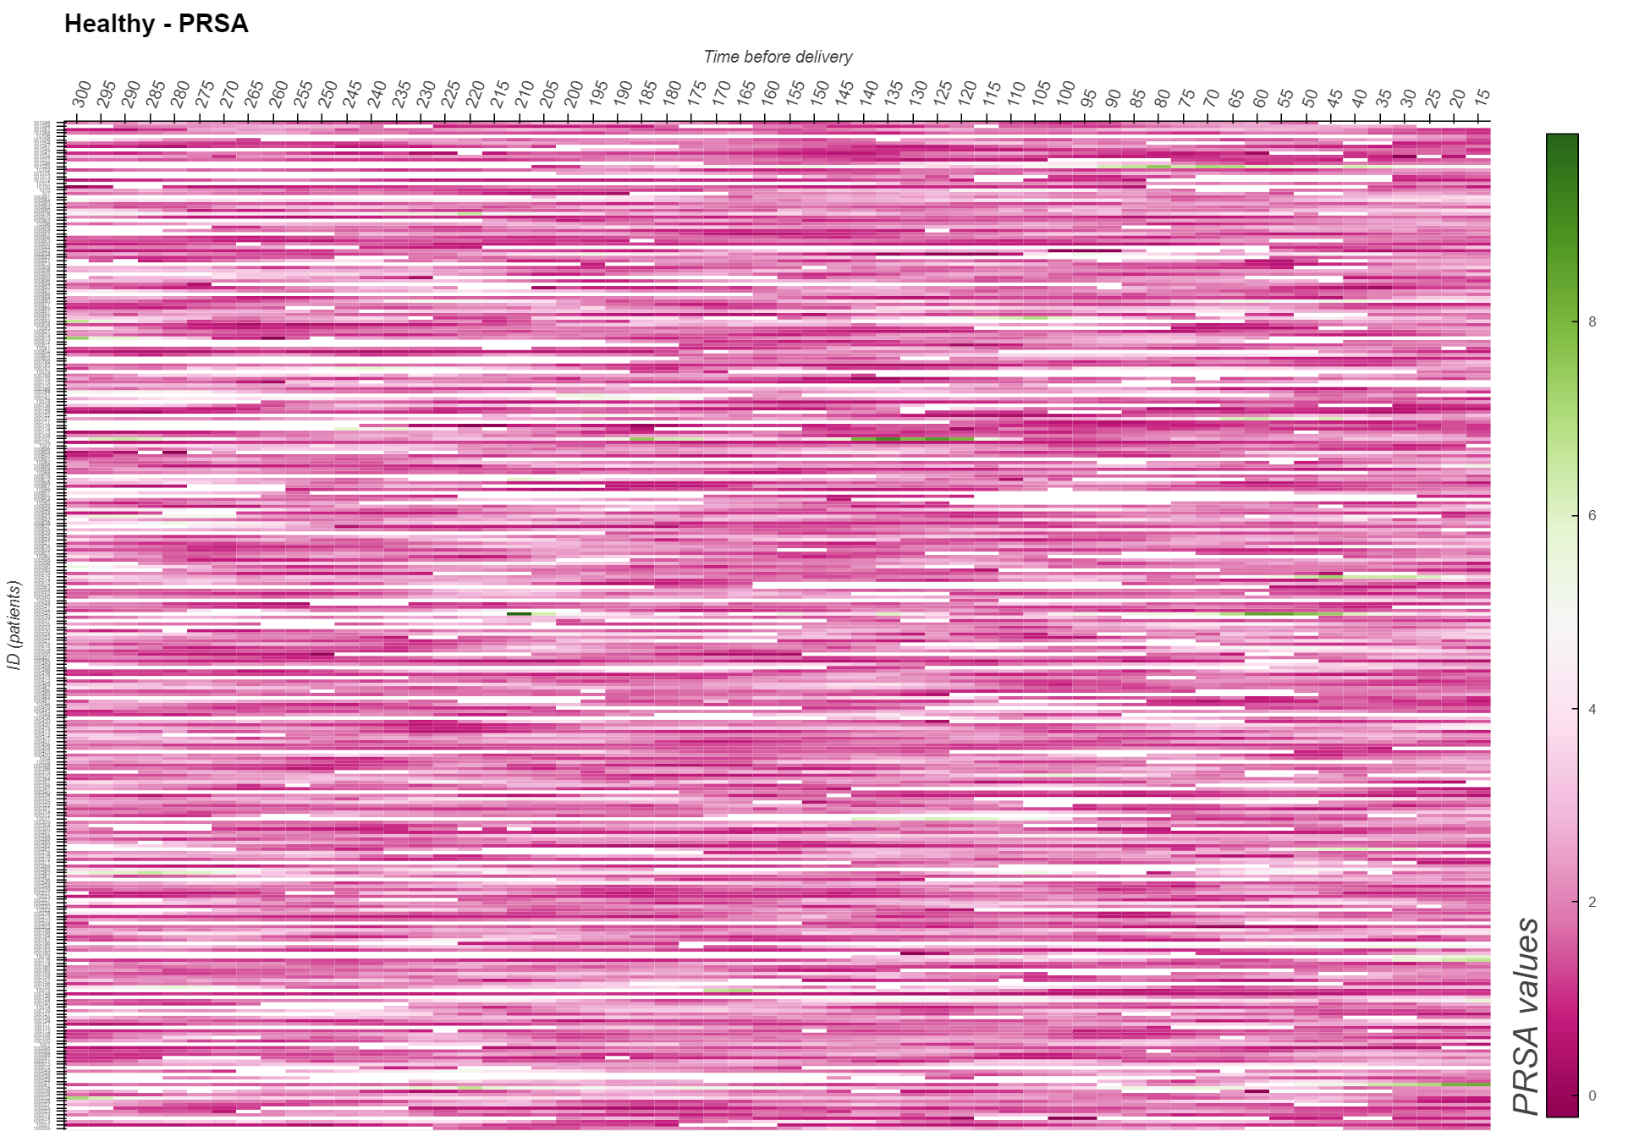
FHR features - PRSA (phase rectified signal averaging for dec. capacity)

Slide 41
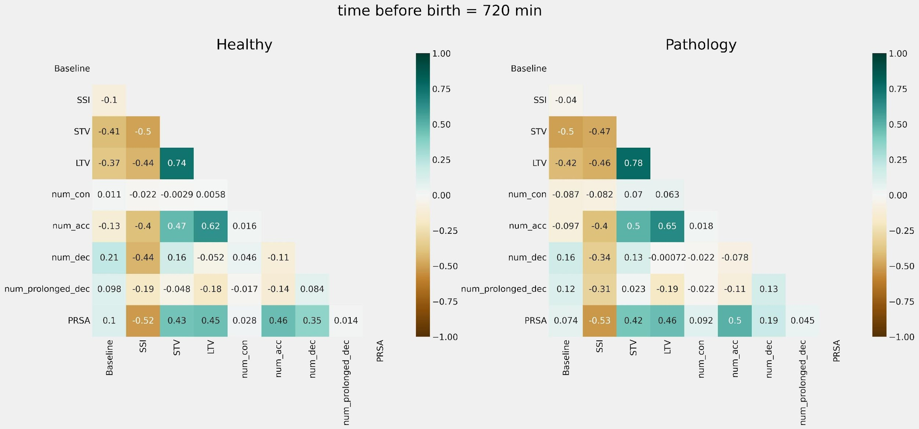
FHR features - Correlation
Feature correlation 12 hours before birth (also done at 30, 60, 120, and 180 mins).

Slide 42
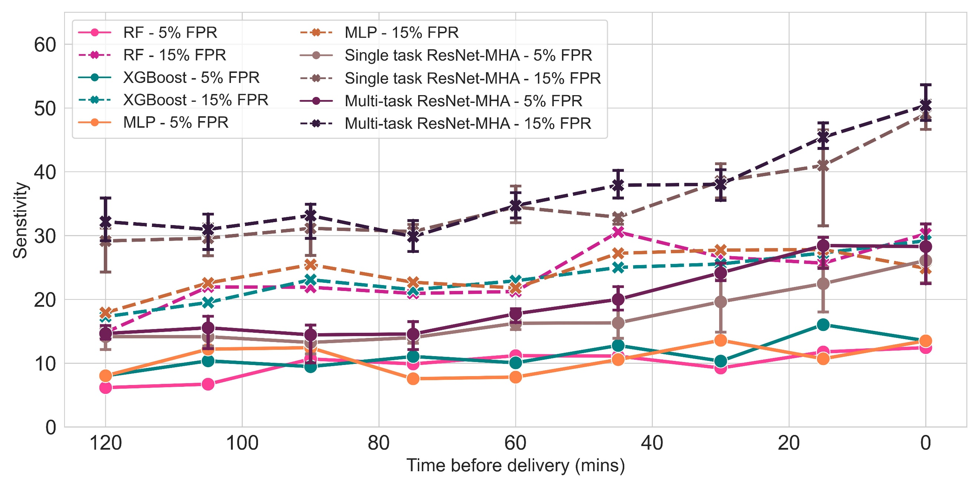
Baseline models – to compare the performance of our model
The nine features were used to train Random Forest (RM), Extreme Gradient Boosting (XGBoost), and Multilayer Perceptron (MLP) classifiers
Single/Multi task deep learning models

Slide 43



DL architectures
ReLU
1D Convolution
1D Conv block
Birth time
At risk/ Healthy
FHRs
Linear
Sigmoid
BN
3x
FC block
FC block
Drop out
Drop out
FC block
FC block
BN
ReLU
data pre-processing
gap-imputation
1D Convolution
FC block
FC
FC block
1D Conv block
Avg pooling
Deep learning model development
Drop out
data preparation
model training
model evaluation
1D Conv block
FC — Fully connected layer
BN — Batch normalisation
MHA – Multi-head attention
Drop out
1D Conv block
2x
MHA
FHR input
— Add
Positional encoding
The model is based on 1D CNN and multi-head attention mechanisms, which are well-suited for capturing both short and long-term dependencies among the various segments of the fetal heart rate (FHR) data.

Slide 44
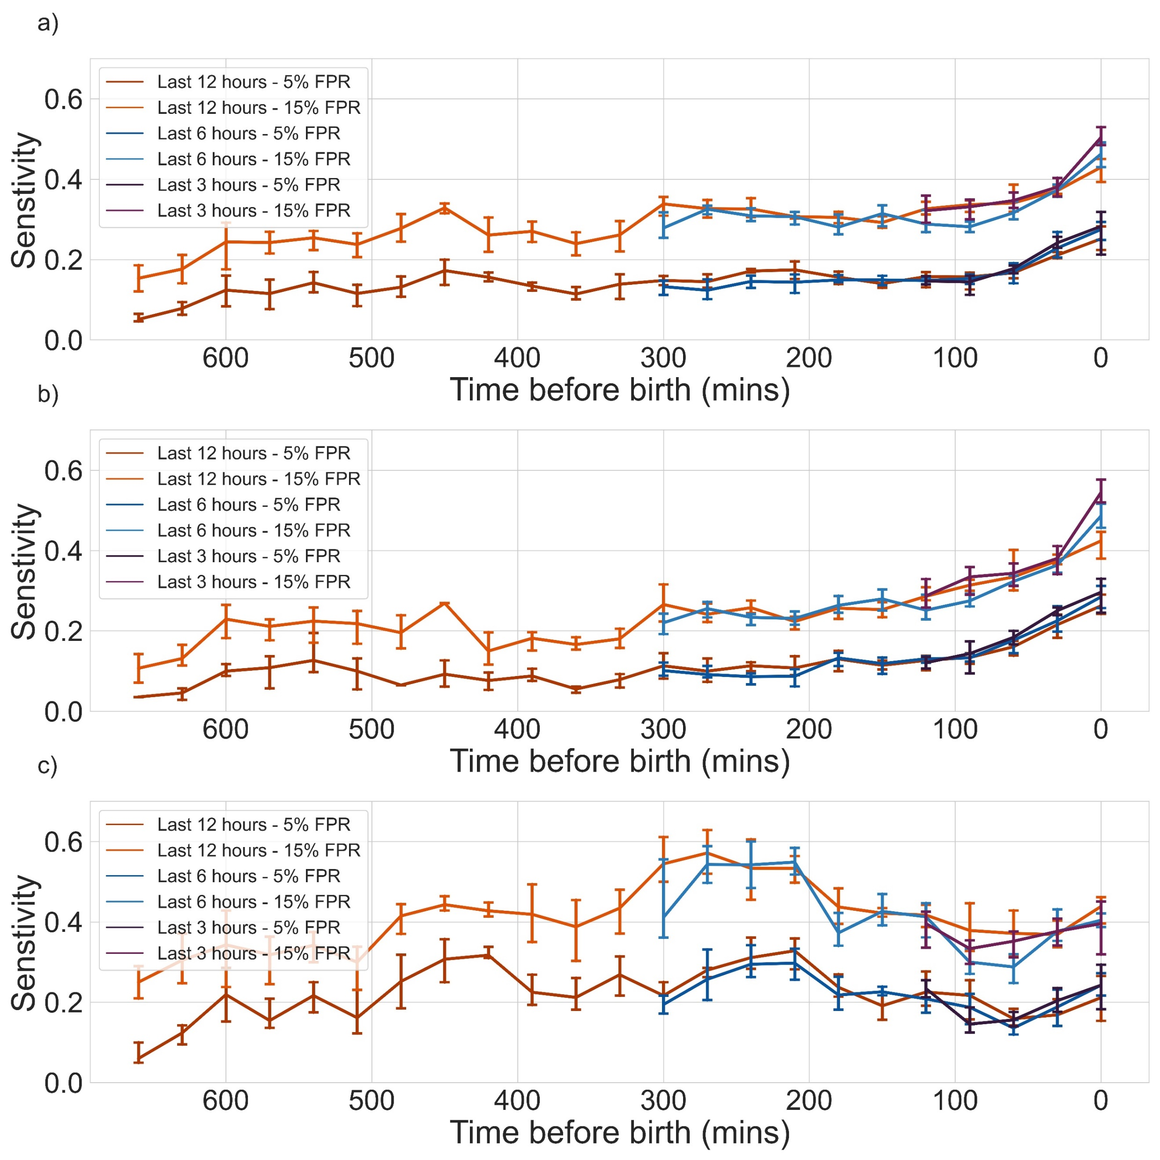
Multi tasking DL model
Performance of the proposed multi-tasking DL model evaluated on the last 3-, 5- and 12-hour data:
  Pathological vs Normal;
  Acidemia vs Normal;
  Severe vs Normal.

Slide 45
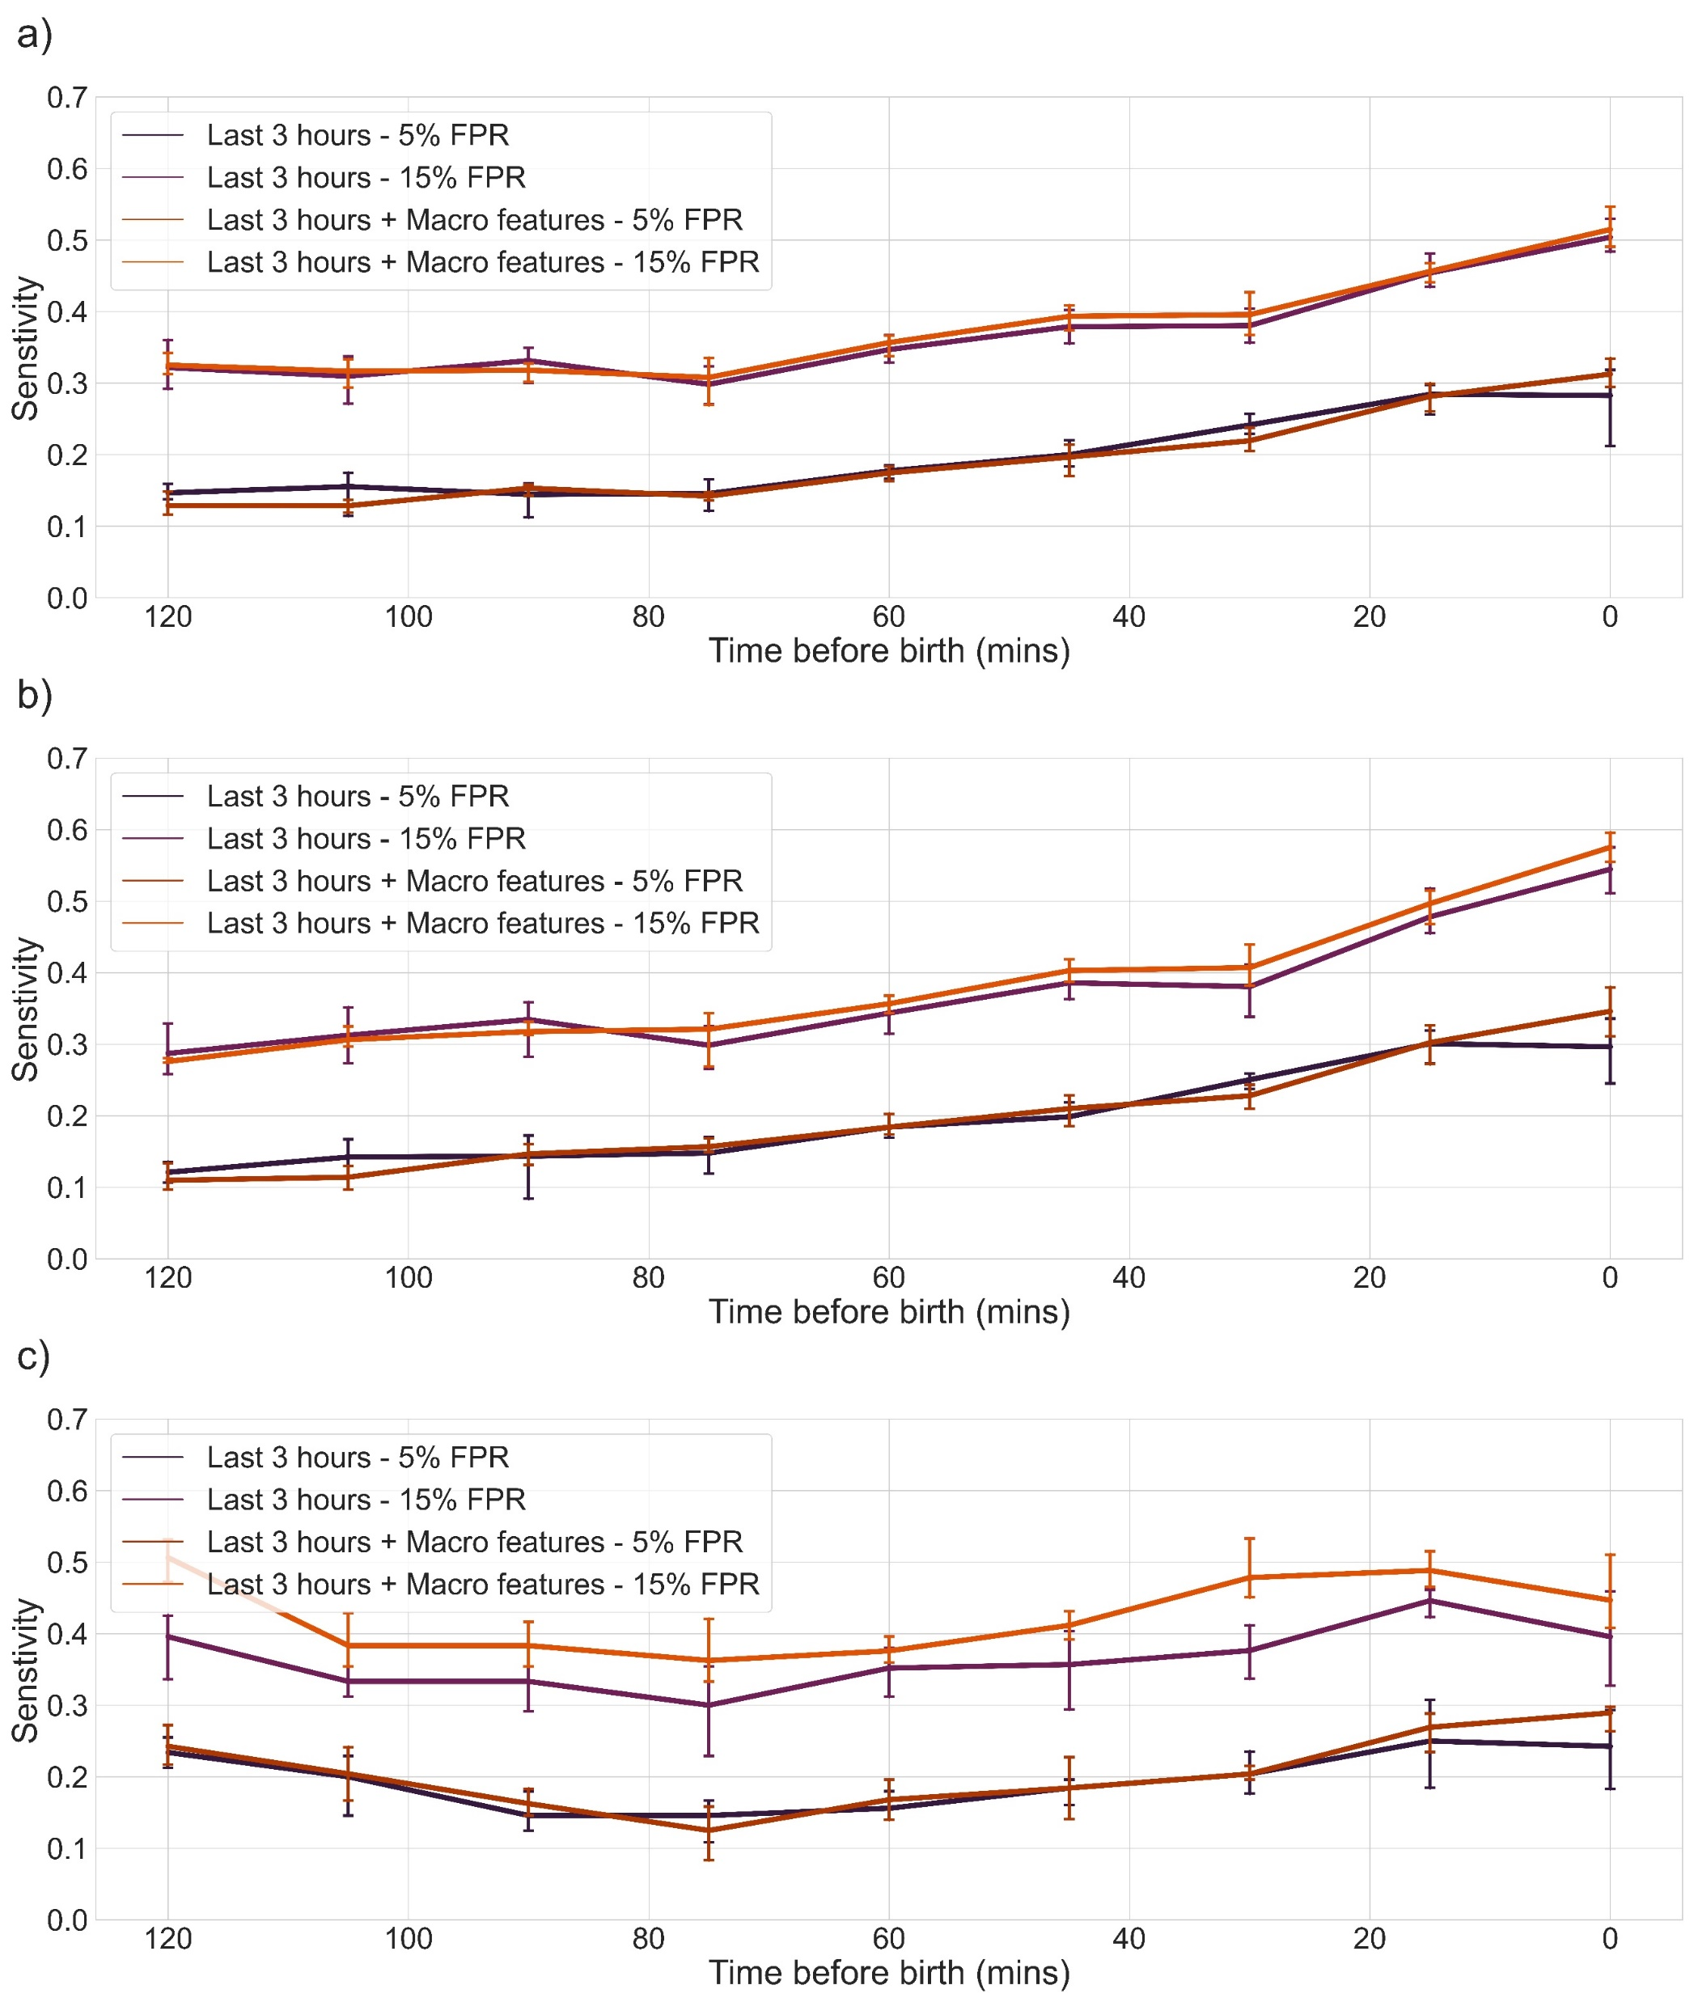
Effect of FHR features
Performance of the proposed multi-tasking deep learning model evaluated on the last three-hours with hand crafted FHR features:
  Pathological vs Normal;
  Acidemia vs Normal;
  Severe vs Normal.

Slide 46
Performance
Model | Metrics
 | FPR | Sensitivity | F1-score
OxSys | 0.14 | 0.38 | 0.16
Clinical Practice | 0.16 | 0.33 | 0.13
Our model | 0.15 | 0.50 | 0.16
Performance of the model evaluated at fifteen minutes before birth (FPR – false positive rate: FP/(FP+TN); Sensitivity (TPR): TP/(TP+FN); F1-score combines the Precision and Recall.

Slide 47
Conclusion
Results show the potential of the developed DL models to improve the accuracy of CTG interpretation and provide early warning for clinical staff when there is a risk of adverse birth outcomes
Future research should explore several avenues to enhance its performance, such as incorporating additional clinical data (e.g., uterine environment), and pre-training the model on larger sequence prediction tasks
Beyond the project – clinical and societal impact (external validation; usability/trust; and commercialisation)

Slide 48
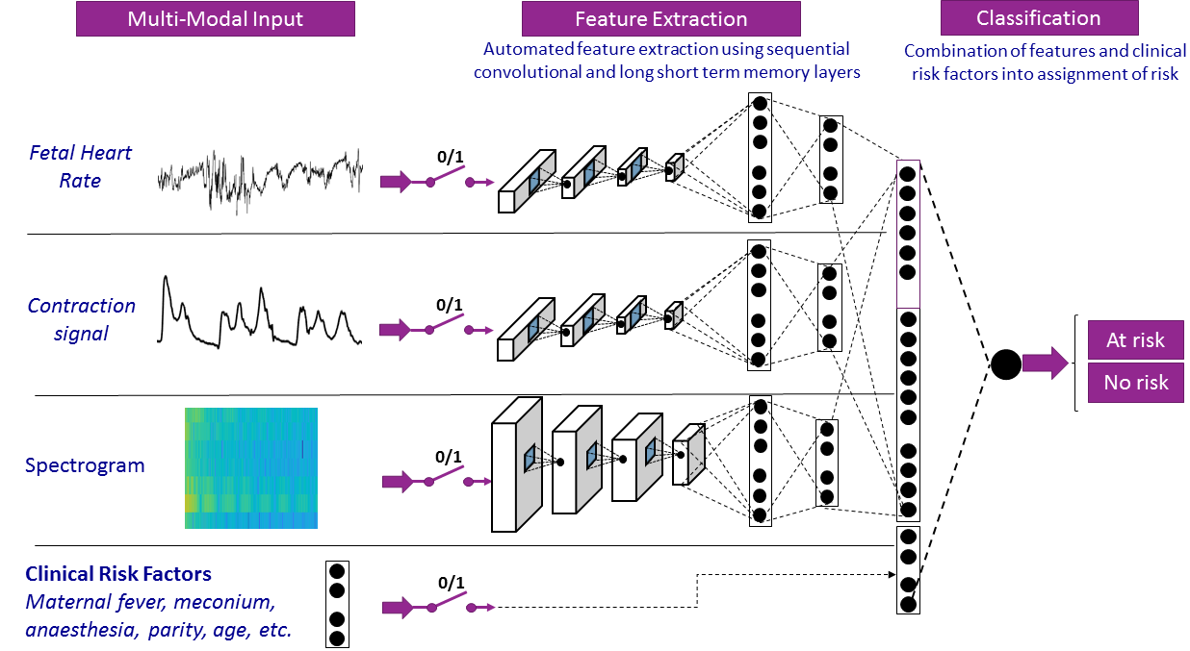
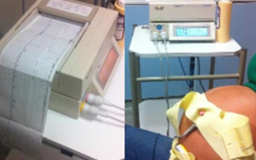
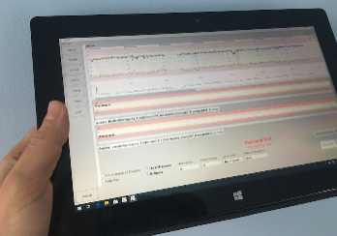

Goal: By the bed, handheld device that implements DL models to help Obstetricians take informed decision when assessing the risk of complications for the fetal health during labour.
Multimodal DNN incorporating stacked CNN/LSTM/MH attention models (with gates).
Standard CTG at the onset of labour
Wireless CTG capture
Output
Individualised risk score for the fetus and recommendations
Touch screen input of clinical risk factors

Slide 49



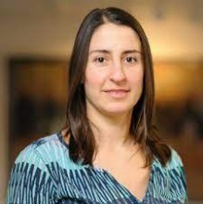


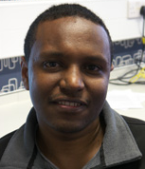
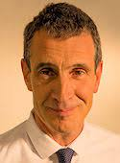
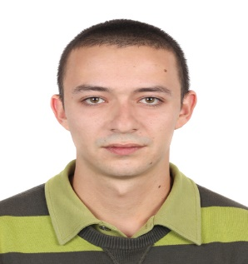
The Project Team
Dr Ivan Jordanov
Reader in Computational Intelligence,
School of Computing,
University of Portsmouth
ivan.jordanov@port.ac.uk
Dr. Antoniya Gergieva
Associate Professor & Scientific Director,
Oxford Centre for Labour Monitoring, Nuffield Dept. of Women's & Reproductive Health,
Wolfson College, University of Oxford,​
antoniya.georgieva@wrh.ox.ac.uk
Dr Raymond Lee
Professor of Biomechanics,
Faculty of Technology,
University of Portsmouth
raymond.lee@port.ac.uk
Dr Ana Namburete
Research Lecturer (Rokos Fellow and Tutor in Computer Science), Dept. of Computer Science, Pembroke College, University of Oxford
ana.namburete@cs.ox.ac.uk
Dr Daniel Asfaw
Research Fellow,
School of Computing,
University of Portsmouth
Daniel.Asfaw@port.ac.uk
MD Lawrence Impey
Consultant in Obstetrics and Fetal Medicine,
John Radcliffe Hospital Oxford,
Director of training in maternal and fetal medicine,
NHS Oxford University Hospitals
Lawrence.Impey@ouh.nhs.uk
Mr Kristiyan Georgiev
Research Assistant,
Nuffield Department of Women’s & Reproductive Health, University of Oxford
kristiyan.georgiev@wrh.ox.ac.uk

Slide 50
Thank you!

