Slide 1


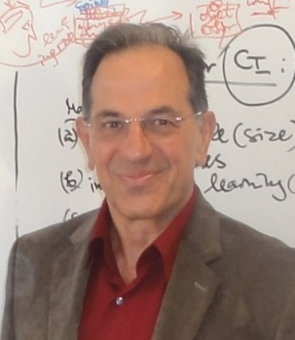

“111 Centre on Biological Computing and Artificial Intelligence” , Dalian University (DLU)
Course: Multi-modal Data Science and Engineering (MDSE)
Course organiser: Prof. Shihua Zhou
Course presenter
  Prof Nikola Kasabov
  Visiting Professor at Dalian University
  Life FIEEE, FRSNZ, FINNS, DVF RAE UK
  Founding Director KEDRI
  Professor, Auckland University of Technology, NZ
  George Moore Chair/Professor, Ulster University, UK
  Honorary Professor, University of Auckland NZ , Peking University China
  Visiting Professor IICT/Bulgarian Academy of Sciences and Teesside University UK
  Doctor Honoris Causa Obuda University Budapest
  Director, Knowledge Engineering Consulting Ltd (https://www.knowledgeengineering.ai)
  Assistant Lecturer
  Doct Iman AbouHassan
  iabouhassan@tu-sofia.bg
  abouhassan.iman@gmail.com

Slide 2
Research Course 2 DLU 2024
Multimodal Data Science and Engineering (MDSE)
Course by research papers.
Every topic will include:
1. Topic/task/problem specification
2. Previously published methods for solving the problem
3. Description of the new method and the publication where it is published
4. Software implementation, experimental results and discoveries
5. Applications
6. Future work to be done for this problem and questions for individual work
Additional materials: - relevant papers;
- https://www.knowledgeengineering.ai/china
ZOOM link for all lectures: https://us05web.zoom.us/j/4658730662?pwd=eFN0eHRCN3o4K0FaZ0lqQmN1UUgydz09

Slide 3
What is MDSE and why we need it?
Definition: MDSE is a new discipline in science and engineering that develops new methods and their engineering implementations for integrated processing of multiple modalities (e.g. different types) of data into one system, including different time and space scales, for a better performance when compared with systems that deal with single modalities.
Advantages:
MDSE offers a wholistic approach to a better problem solving, considering multiple related factors.
MDSE can extract novel associations between different modalities of data for new knowledge discovery.
MDSE can offer a better prediction of future events.
Examples:
Integrating multiple medical factors in health predictive modelling
Integrating multiple sensory information for environment prediction
Integrating audio and visual information
Integrating multiple factors for financial and economic prediction

Slide 4
MDSE
Full List of Topics/Lectures:
1.Introduction to the course: What is MDSE and why we need it?
2. Methods for MDSE:
paper: S.Budhraja, B.Singh, S.Tan, M.Dobrojeh, Z.Doborjeh, W.Goh, E.Lai and N.Kasabov, Mosaic LSM: A Liquid State Machine Approach for Multimodal Longitudinal Data Analysis, Proc. International Joint Conference on Neural Networks (IJCNN), Gold Coast, Australia, 2023, pp. 1-8, doi: https://doi.org/10.1109/IJCNN54540.2023.10191256; https://ieeexplore.ieee.org/document/10191256. IEEE, 2023, ISBN:978-166548867-9
Software NeuGems: https://kedri.aut.ac.nz/news-and-events/introducing-neurogems
3. MDSE for biomedical engineering
Paper 1: M. Doborjeh, N. Kasabov, Z. Doborjeh, R. Enayatollahi, E. Tu, A. H. Gandomi, Personalised modelling with spiking neural networks integrating temporal and static information, Neural Networks, 119 (2019),162-177.
Paper 2: Sengupta, N., McNabb, C. B., Kasabov, N., & Russell, B. R. (2018). Integrating Space, Time, and Orientation in Spiking Neural Networks: A Case Study on Multimodal Brain Data Modelling. IEEE Transactions on Neural Networks and Learning Systems, 29(11). doi:10.1109/TNNLS.2018.2796023
Paper 3: Li, Jiawei; Liu, Jinyuan; Zhou, Shihua; Zhang, Qiang; Kasabov, Nikola, , "GeSeNet: A General Semantic-guided Network with Couple Mask Ensemble for Medical Image Fusion" , IEEE Transactions on Neural Networks and Learning Systems, DOI: https://doi.org/10.1109/TNNLS.2023.3293274, 21 July 2023.
4. MDSE for predictive modelling of multisensory streaming data
Main: N.Kasabov, Chapter 19, Time-space, spiking neural networks and brain-inspired AI, Springer-Nature, 2019.
Additional papers:
H Liu, G Lu,Y Wang, N Kasabov, Evolving spiking neural network model for PM2.5 hourly concentration prediction based on seasonal differences: A case study on data from Beijing and Shanghai, Aerosol and Air Quality Research, vol.21, Issue 2, Feb. 2021, 200247, https://doi.org/10.4209/aaqr.2020.05.0247
Laña I, Lobo JL, Capecci E, Del Ser J, Kasabov N, Adaptive long-term traffic state estimation with evolving spiking neural networks, Transportation Research Part C: Emerging Technologies 101:126-144 2019, https://doi.org/10.1016/j.trc.2019.02.011
5. MDSE for integrated audio-visual information processing
- Paper 1: N. Kasabov et al, AVIS: a connectionist-based framework for integrated auditory and visual information processing. Inf. Sci. 133, 137–148 (2000)
- Paper2: N Kasabov, B Bhattacharya, D Patel, N Aggarwal, T Bankar, I AbouHassan, Cognitive Audio-Visual Associative Memories using Brain-inspired Spiking Neural Networks with Case Studies on Moving Object Recognition (IEEE Trans. Cognitive and Devel. Systems, 2023).
6. MDSE for integrating times series and text data in finance and economics (Ms Iman AbouHassan)
Paper: I AbouHassan, N Kasabov, V Jagtap, P Kulkarni, Spiking neural networks for predictive and explainable modelling of multimodal streaming data on the Case Study of Financial Time Series Data and on-line news, SREP, Springer-Nature, Sci Rep 13, 18367 (2023). https://doi.org/10.1038/s41598-023-42605-0
7. MDSE for integration of brain data and face image data for emotion recognition
- Paper: C Tan; G Ceballos; N Kasabov; N Subramaniyam, FusionSense: Emotion Classification using Feature Fusion of Multimodal Data and Deep learning in a Brain-inspired Spiking Neural Network, Sensors (ISSN 1424-8220), MDPI Publisher, September 2020
8. Revision of the course

Slide 5
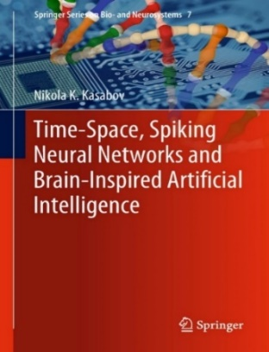
Lecture 4. MDSE for predictive modelling of multisensory streaming data
Problems with multisensory streaming data:
Spatially distributed sensors ;
The spatial distribution may be important to take into account .
Streaming data is collected over time.
To predict events in a future time, spatio-temporal patterns must be learned.
What is the time-lag (the time of data they need to be taken before the event)
What is the time ahead of prediction?
How do we adjust the model on new data that are continuously measured?
Examples:
Ecological modelling
Transport data
Earthquake prediction
Pollution prediction
Wind turbine energy prediction
N.Kasabov, Chapter 19, Time-space, spiking neural networks and brain-inspired AI, Springer-Nature, 2019.

Slide 6
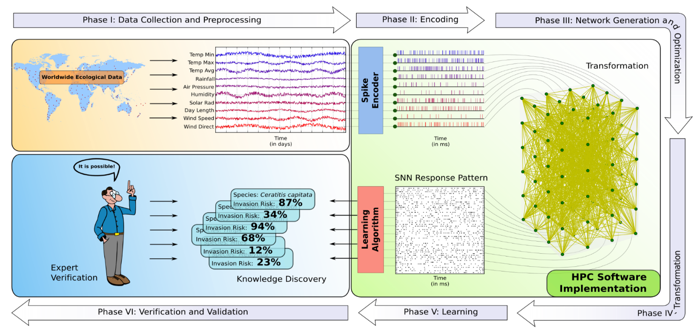
Ecological modelling: predicting the risk of establishment of harmful species

Slide 7
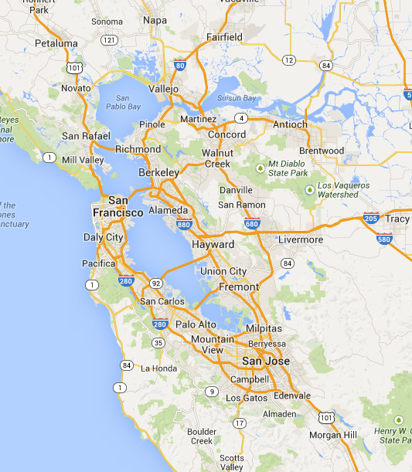
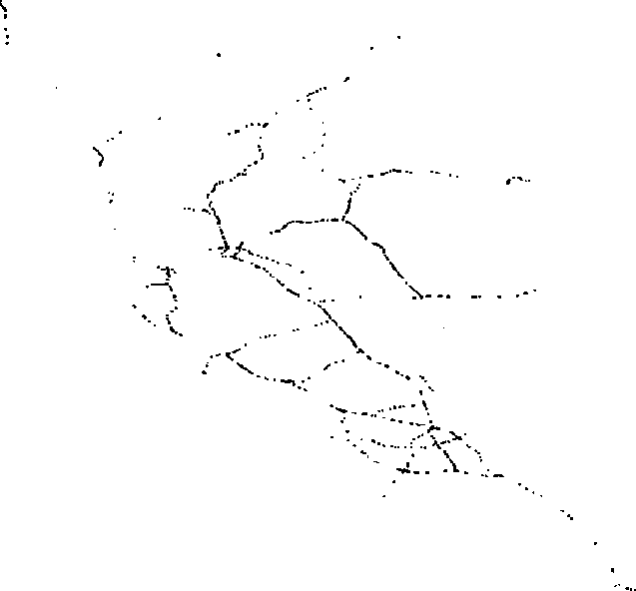
Transport traffic prediction
Additional paper: Laña I, Lobo JL, Capecci E, Del Ser J, Kasabov N, Adaptive long-term traffic state estimation with evolving spiking neural networks, Transportation Research Part C: Emerging Technologies 101:126-144 2019, https://doi.org/10.1016/j.trc.2019.02.011

Slide 8
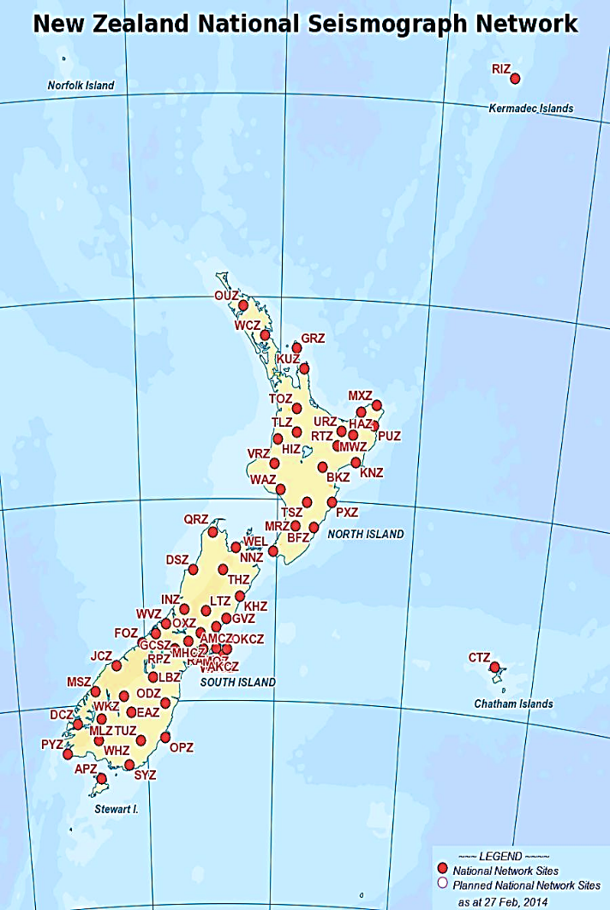
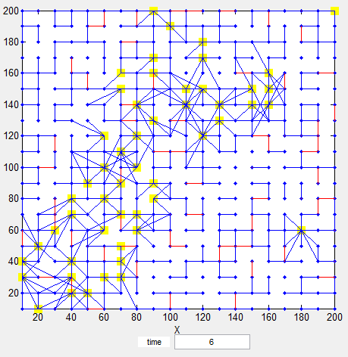
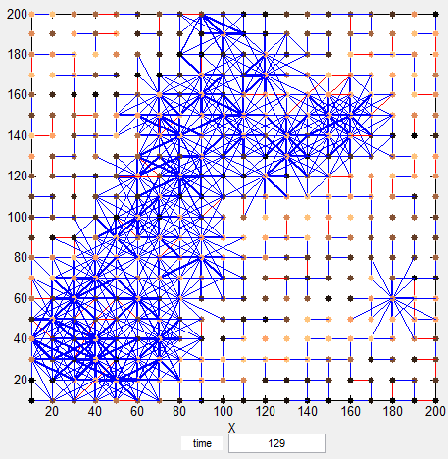
Early prediction of earthquakes based on multimodal spatio-temporal data
Measure NeuCube SVM MLP 1h ahead 91.36% 65% 60%
6h ahead 83% 53% 47%
12h ahead 75% 43% 46%
Predicting risk for earthquakes, tsunami, land slides, floods – how early and how accurate?
nkasabov@aut.ac.nz
Notes:
8

Slide 9

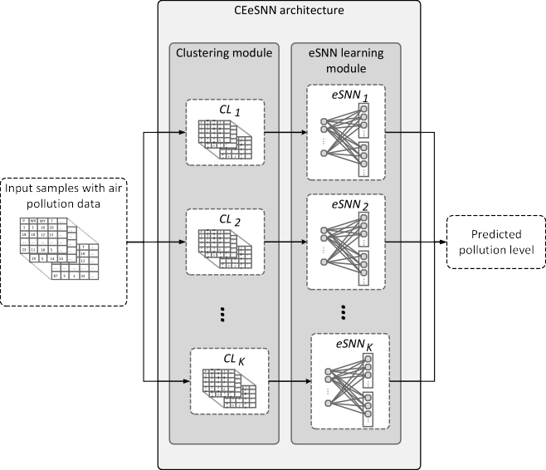
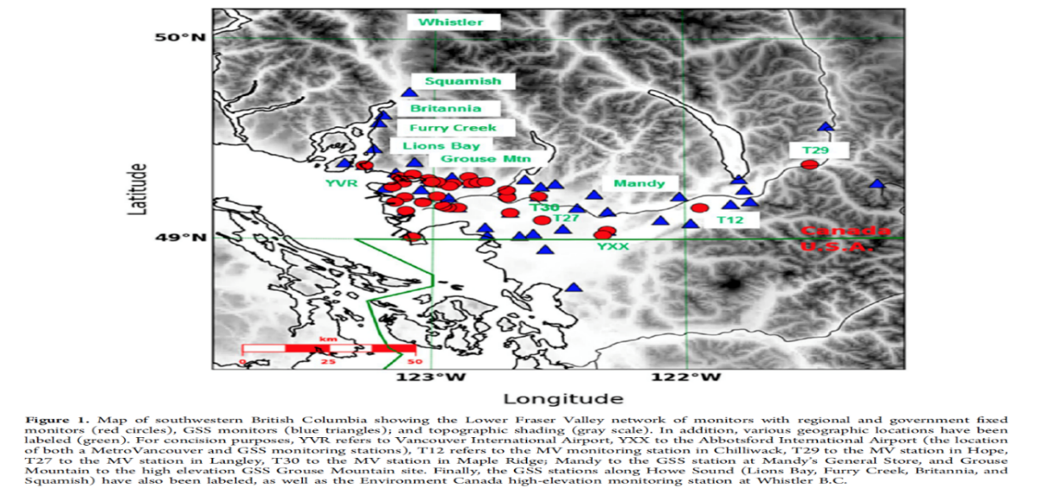
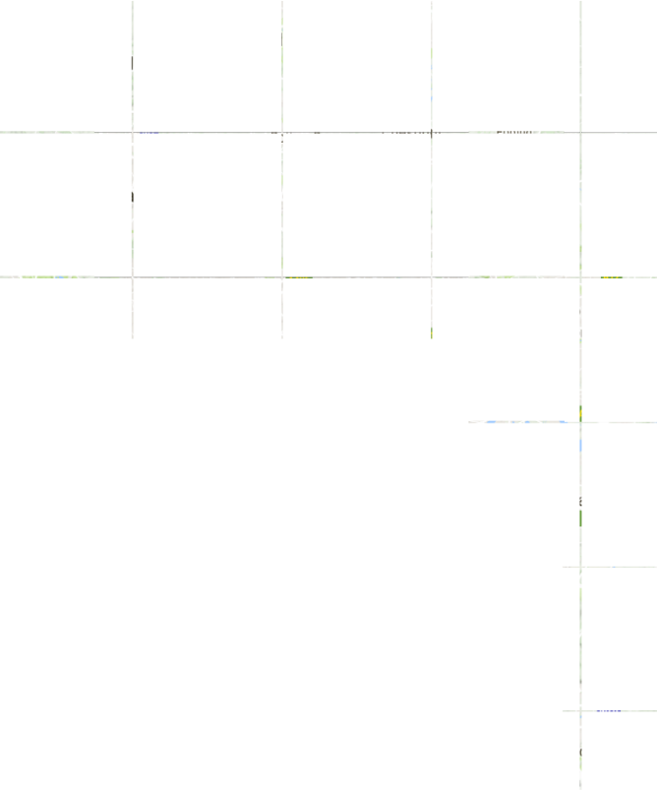



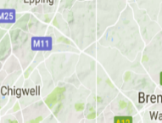






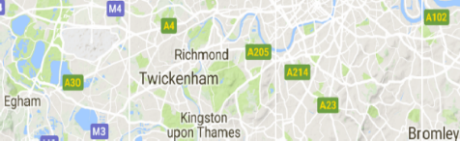
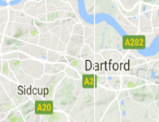

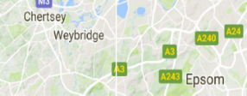
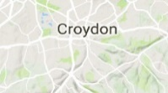

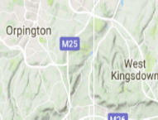










Predictive modelling of streaming data from pollution sensors
Using an ensemble of eSNN for Predicting Hourly Air Pollution in London Area from sensory data
P. S. P Maciaga, N. K. Kasabov, M. Kryszkiewicza, R. Benbenik, Prediction of Hourly Air Pollution in London Area Using Evolving Spiking Neural Networks, Environmental Modelling and Software, Elsevier, vol.118, 262-280, 2019, https://www.sciencedirect.com/science/article/pii/S1364815218307448?dgcid=author
Additional paper: Hengyuan Liu, Guibin Lu,Yangjun Wang, Nikola Kasabov, Evolving spiking neural network model for PM2.5 hourly concentration prediction based on seasonal differences: A case study on data from Beijing and Shanghai, Aerosol and Air Quality Research, vol.21, Issue 2, Feb. 2021, 200247, https://doi.org/10.4209/aaqr.2020.05.0247

Slide 10
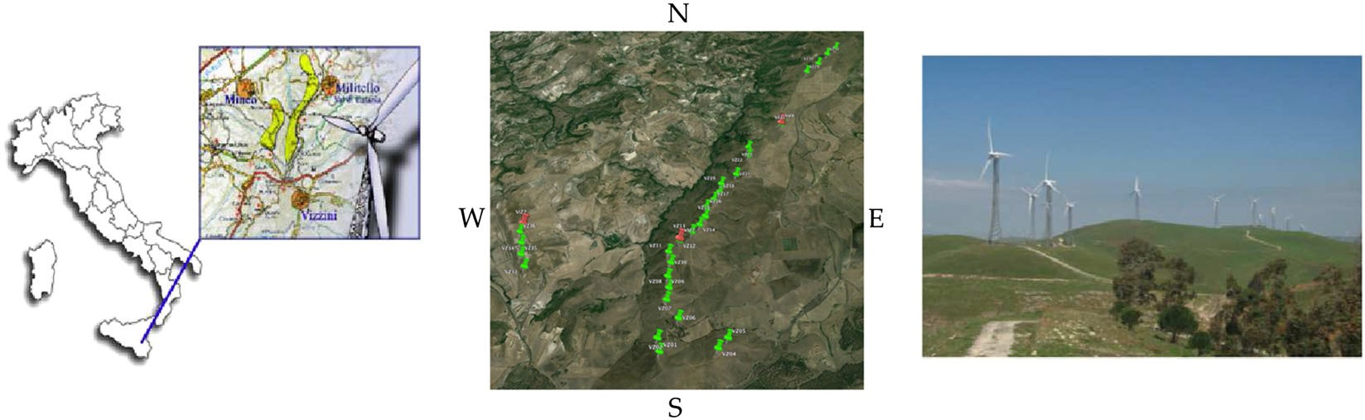
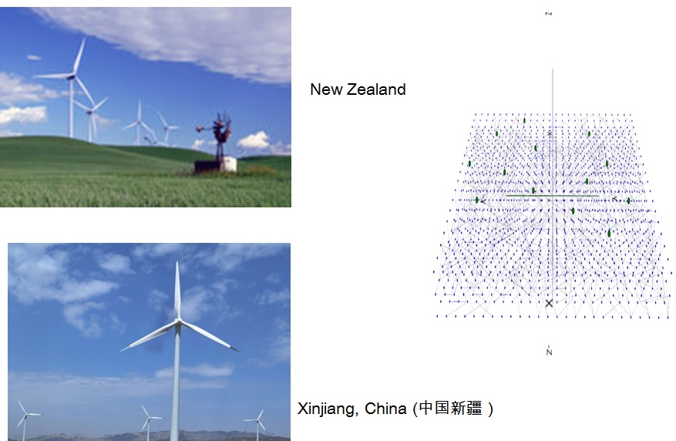
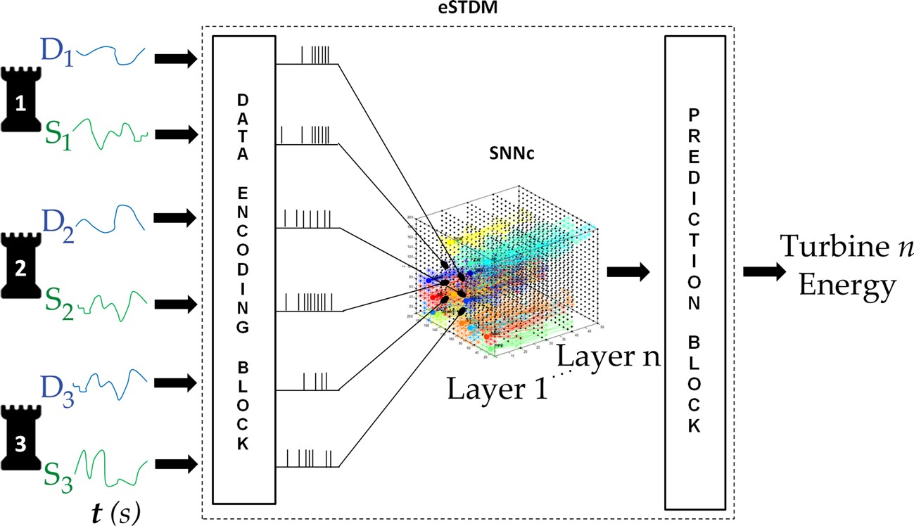
Wind farms energy prediction
Sebastian Brusca , Giacomo Capizzi, Grazia Lo Sciuto, Gianluca Susi, A new design methodology to predict wind farm energy production by means of a spiking neural network–based system, Int J Numer Model. 2019;32:e2267, wileyonlinelibrary.com/journal/jnm, 2017 John Wiley & Sons, Ltd, https://doi.org/10.1002/jnm.2267

