Slide 1
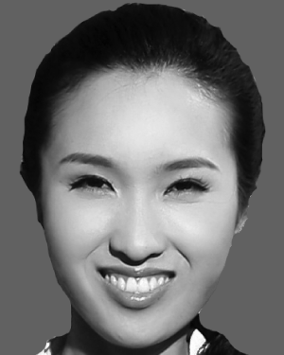
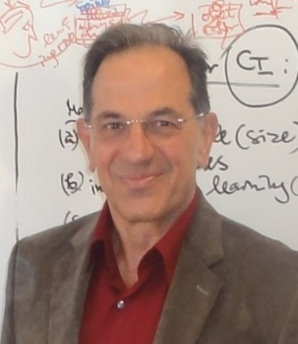


“111 Centre on Biological Computing and Artificial Intelligence” , Dalian University (DLU)
Cognitive Systems Engineering
Course organiser: Prof. Shihua Zhou
Course presenter
  Prof Nikola Kasabov
  Visiting Professor at Dalian University
  Life FIEEE, FRSNZ, FINNS, DVF RAE UK
  Founding Director KEDRI
  Professor, Auckland University of Technology, NZ
  George Moore Chair/Professor, Ulster University, UK
  Honorary Professor, University of Auckland NZ , Peking University China
  Visiting Professor IICT/Bulgarian Academy of Sciences and Teesside University UK
  Doctor Honoris Causa Obuda University Budapest
  Director, Knowledge Engineering Consulting Ltd (https://www.knowledgeengineering.ai)
  Assistant
  Doct Ms Iman AbouHassan
  iabouhassan@tu-sofia.bg
  abouhassan.iman@gmail.com

Slide 2
Research Course DLU 2024
Cognitive System Engineering
Cognitive systems (CogSys) are software-hardware systems that have their structure and functionality based on principles of information processing in the human brain. They are part of AI, but AI includes also other systems that manifest cognitive behaviour, such as speech and image recognition, learning and reasoning, but using other methods , such as statistical, empirical, abstract logic , etc.
The course is by research papers.
Every topic will include:
1. Topic/task/problem specification
2. Previously published methods for solving the problem
3. Description of the method and in the paper under discussion
4. Software implementation, experimental results and discoveries
5. Applications
6. Future work to be done for this problem and questions for individual work
Expected results:
1. Students obtain new knowledge and skills in the area of CogSys for AI applications.
2. Students can learn to take a critical approach to the existing methods and systems.
3. Students can get confidence that they can suggest new methods and to publish them in good journals.
Additional materials: https://www.knowledgeengineering.ai/china
ZOOM link for all lectures: https://us05web.zoom.us/j/4658730662?pwd=eFN0eHRCN3o4K0FaZ0lqQmN1UUgydz09

Slide 3
CogSysEn: Lecture Topics
Introduction to the course
Part I : Learning systems
Deep learning and deep knowledge representation in the human brain
-Chapter 3 from: N.Kasabov, Time-space, spiking neural networks and brain-inspired artificial intelligence, Springe-Nature, 2029
3.Modelling brain dynamics
- Benuskova, L., Kasabov, N. Modeling brain dynamics using computational neurogenetic approach. Cogn Neurodyn 2, 319–334 (2008). https://doi.org/10.1007/s11571-008-9061-1
4. Evolving learning systems
- N. Kasabov, "Evolving fuzzy neural networks for supervised/unsupervised online knowledge-based learning," in IEEE Transactions on Systems, Man, and Cybernetics, Part B (Cybernetics), vol. 31, no. 6, pp. 902-918, Dec. 2001, doi: 10.1109/3477.969494.
- NeuCom software (https://theneucom.com): EFuNN
5. Neuro—fuzzy learning and inference systems: DENFIS
- Kasabov, N. K., & Song, Q. (2002). DENFIS: dynamic evolving neural-fuzzy inference system and its application for time-series prediction. IEEE transactions on Fuzzy Systems, 10(2), 144-154.
- DENFIS software in Python.
6. Spatio-temporal learning systems: SNN
- N. Kasabov, K. Dhoble, N. Nuntalid, G. Indiveri, Dynamic evolving spiking neural networks for on-line spatio- and spectro-temporal pattern recognition. Neural Networks, 41(1995), 188–201 (2013). https://doi.org/10.1016/j.neunet.2012.11.014.
- Software deSNN
7. Reservoir computing and Brain-inspired SNN
N. Kasabov, NeuCube: a spiking neural network architecture for mapping, learning and understanding of spatio-temporal brain data. Neural Netw. 52(2014), 62–76 (2014).
N. Kasabov et al, Evolving spatio-temporal data machines based on the NeuCube neuromorphic framework: Design methodology and selected applications, Neural Networks, v.78, 1-14, 2016. http://dx.doi.org/10.1016/j.neunet.2015.09.011.
8. Integrated learning systems:
- P. Koprinkova-Hristova, D. Penkov, S. Nedelcheva, S. Yordanov and N. Kasabov, "On-line Learning, Classification and Interpretation of Brain Signals using 3D SNN and ESN," 2023 International Joint Conference on Neural Networks (IJCNN), Gold Coast, Australia, 2023, pp. 1-6,
doi: https://doi.org/10.1109/IJCNN54540.2023.10191974,
- AbouHassan et al, NeuDen: Integrating evolving Neuromorphic spiking neural networks and Dynamic evolving neuro-fuzzy systems for predictive and explainable learning of multiple time series

Slide 4
CogSysEn: Lecture Topics
Part II. Associative memories
9. Evolving Associative Memories in bio-neuro systems and in SNN
- Kasabov, Nikola (2023). STAM-SNN: Spatio-Temporal Associative Memories in Brain-inspired Spiking Neural Networks: Concepts and Perspectives. TechRxiv. Preprint. https://doi.org/10.36227/techrxiv.23723208.v1
10. Associative memories for neuroimaging data: EEG and fMRI
- N K. Kasabov, H Bahrami, M Doborjeh, A Wang, Brain Inspired Spatio-Temporal Associative Memories for Neuroimaging Data: EEG and fMRI, Bioengineering 2023, MDPI 10(12), 1341 https://doi.org/10.3390/bioengineering10121341, www.mdpi.com/journal/bioengineering
11. Audio-visual associative memories
- N Kasabov, B Sen Bhattacharya, D Patel, N Aggarwal, T Bankar, IAbouHassan, Cognitive Audio-Visual Associative Memories using Brain-inspired Spiking Neural Networks with Case Studies on Moving Object Recognition .
12. Predictive associative memories for time series
- AbouHassan, I; Kasabov, N; Bankar, T; Garg, R; Sen Bhattacharya, B (2023). PAMeT-SNN: Predictive Associative Memory for Multiple Time Series based on Spiking Neural Networks with Case Studies in Economics and Finance. TechRxiv. Preprint. https://doi.org/10.36227/techrxiv.24063975.v1, https://papers.ssrn.com/sol3/papers.cfm?abstract_id=4665533
Part III. Software and Hardware Implementation of CogSys.
13. Software implementation of CogSys in Python
- NeuCubePy
14. Neuromorphic implementation of CogSys. China neuromorphic hardware systems for CogSys.
- J. Behrenbeck, Z. Tayeb, C. Bhiri, C. Richter, O. Rhodes, N. Kasabov, S. Furber, J. Conrad, Classification and Regression of Spatio-Temporal EMG Signals using NeuCube Spiking Neural Network and its implementation on SpiNNaker Neuromorphic Hardware. J. Neural Eng. (IOP Press, Article reference: JNE-102499) (2018). http://iopscience.iop.org/journal/1741-2552.
- paper for CogSys on Loihi chip and on China neuromorphic chips
15. Quantum computation
- Ravi , N. Kasabov et al, (2023). From Quantum Computing to Quantum-inspired Computation for Neuromorphic Advancement – A Survey. TechRxiv. Preprint. https://doi.org/10.36227/techrxiv.24053250.v1
16. Revision of the course

Slide 5
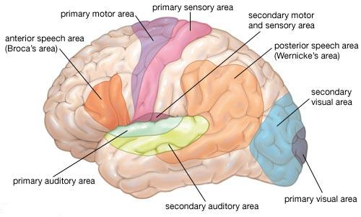
Different parts of the brain control different functions and they are connected through neuronal connections to make associative memories (AM)

Slide 6

Learning in the brain results in spatio-temporal AM (STAM):
Image recognition and action
Deep serial processing of visual stimuli in humans for image classification and action.
Location of cortical areas: V1 = primary visual cortex, V2 = secondary visual cortex, V4 = quartiary visual cortex, IT = inferotemporal cortex, PFC = prefrontal cortex, PMC = premotor cortex, MC = motor cortex.
(from L.Benuskova, N.Kasabov, Computational neurogenetic modelling, Springer, 2007)

Slide 7
Language learning is also based on STAM
(from L.Benuskova, N.Kasabov, Computational neurogenetic modelling, Springer, 2007)
The basic model of language processing during the simple task of repeating the word that has been heard is the Wernicke-Geschwind model (Mayeux and Kandel 1991). A language task involves transfer of information from the inner ear through the auditory nucleus in thalamus to the primary auditory cortex (Brodmann’s area 41), then to the higher-order auditory cortex (area 42), before it is relayed to the angular gyrus (area 39). From here, the information is projected to Wernicke’s area (area 22) and then, by means of the arcuate fasciculus, to Broca’s area (44, 45), where the perception of language is translated into the grammatical structure of a phrase and where the memory for word articulation is stored. This information about the sound pattern of the phrase is then relayed to the facial area of the motor cortex that controls articulation so that the word can be spoken.

Slide 8
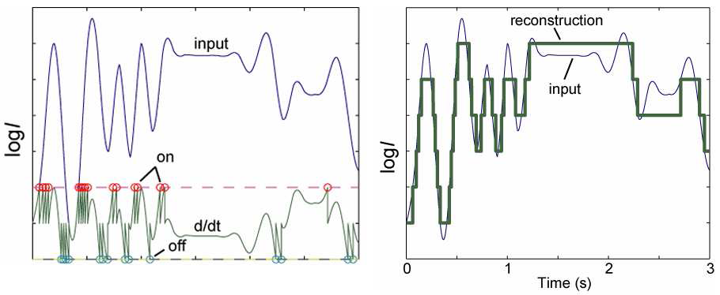
Encoding input information for building STAM in the brain and in brain-inspiored spiking neural networks (SNN)
A spike is generated only if a change in the input data occurs beyond a threshold
Silicon Retina (Tobi Delbruck, INI, ETH/UZH, Zurich ), DVS128: Retinotopic
Silicon Cochlea ( Shih-Chii Liu, INI, ETH/UZH, Zurich): Tonotopic
Threshold-based encoding – retinotopic Tonotopic organization of the cochlea:
https://sites.google.com/site/jayanthinyswebite

Slide 9
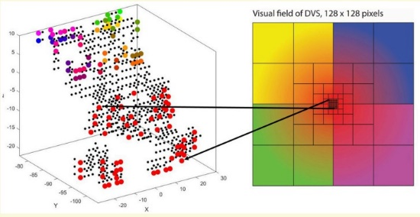
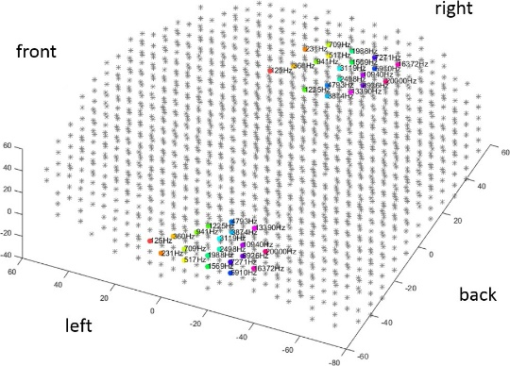
Mapping input video and audio information in the NeuCube brain inspired SNN

Slide 10
Multimodal audio-visual STAM:
Moving object recognition when missing modality
Paper: Kasabov, N., B.Bhattacharya, I.Abouhassan et al, AViAM: Audio-Visual Associative Memories using Brain-inspired Spiking Neural Networks and a Case Study of Moving Object Recognition, Neural Networks with Applications, Springer-Nature (submitted), 2024,
- Training on both modalities
- Recall on only one modality
- Case studies on airplane and train recognition

Slide 11
Model Accuracy obtained with the NeuCube simulator when trained and tested with audio-visual data of an airplane flying on its approach to landing: class 1: object; class 2: no object.
Training | Testing | Classifier Accuracy (mean, std)
 |  | Class 1 | Class 2 | Overall
audio | audio | 30, 31.455 | 100, 0 | 65, 15.72
visual | visual | 50, 20 | 59, 15.18 | 54.5, 13.56
audio-visual | visual (with zero-audio) | 32, 13.61 | 86, 19.57 | - 59
 | audio (with zero-visual) | 90, 10.25 | 99, 4.47 | 95
 | audio-visual | 56, 8.20 | 94, 9.40 | 75, 5.12

Slide 12
Model Accuracy obtained on the NeuCube simulator when trained and tested with audio-visual data of an
APPROACHING TRAIN.
Training | Testing | Classifier Accuracy (mean, std)
 |  | Class 1 | Class 2 | Overall
audio | audio | 85.38, 8.24 | 100, 0 | 92.69, 4.12
visual | visual | 80.38, 9.49 | 98.84, 2.81 | 89.61, 5.59
audio-visual | visual (with zero-audio) | 28.84, 13.86 | 100, 0 | -
 | audio (with zero-visual) | 100, 0 | 89.61, 5.73 | -
 | audio-visual | 84.23, 6.35 | 100, 0 | 92.11, 3.17

Slide 13
Discussions
Advantages:
  A model can be recalled on partial data (less features and less time) and perform well
  No need for every data set on the same problem to create a separate model, but to recall an existing one with partial data;
  Building very large global models (such as LLM) on specific problems and recalling them locally
  Extracting both global and local knowledge
Challenges:
- Need to evaluate in advance if global model of AM will perform well on local data
  - Continuous adaptation of the global AM model on new data (life-long learning)

